Slide 1



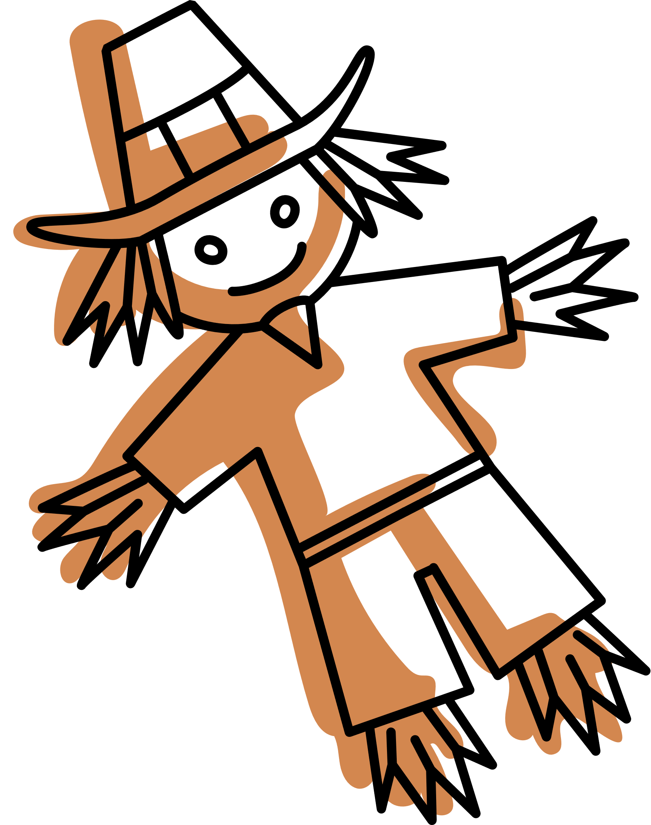








Bonfire Night
5th November 2025
Option 1
Bonfire Bangers and Mash
Option 2
Firecracker Veggie chilli
Option 3
Jacket Potato with Filling
On the Side
peas and sweetcorn
Desserts
Campfire chocolate crispy cake

Slide 2
Bonfire Night
5th November 2025
Option 1
P3 Bonfire Bangers and SD1 Mash
Option 2
V239 Firecracker Veggie chilli WITH SD84 RICE
Option 3
Jacket Potato with Filling
On the Side
SD18 peas and SD19 sweetcorn
Desserts
TD25 Campfire chocolate crispy cake

Slide 3
Bonfire Night
5th November 2025
Fact Sheet
-
Bonfire Night, or Guy Fawkes Night is celebrated every year on the 5th November
-
It celebrates the failure of the gunpowder plot by Guy Falkes
-
In 1605 - Guy Fawkes attempted to blow up Parliament and assassinate King James I
-
Fawkes wanted to end protestant rule and restore a catholic monarch to the throne
Did you know - the term ‘guy’ meaning a man or fellow, comes from Guy Fawkes name!

Slide 4
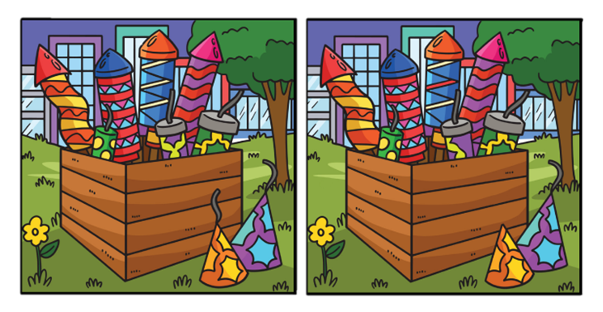
Bonfire Night
5th November 2025
Activity
Can you spot the 5 differences??
Can you unscramble these words??
Kips rollar
Wor Fierk
Gub niortf
Yug we kafs
he boffin from vet
pale martin

