Slide 1
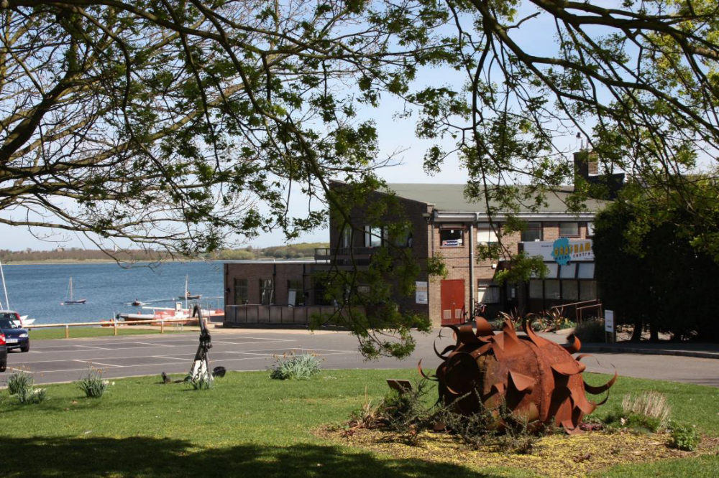

Slide 2

Residential
Schools visit
Wednesday 7th October -
Friday 10th October
Arrive 10:00 Wednesday
Leave 14:30 Friday
Grafham Water Centre

Slide 3
“At Grafham Water Centre we aim to Change Young Peoples’ lives by providing positive, challenging, new outdoor learning experiences. We broaden young people’s horizons and foster a respect for the natural environment and people around them by creating a community focused residential environment. Our ethos is based on understanding, inclusion and opportunities for all.”
Notes:
Mission statement

Slide 4



All staff are DBS checked.
Our Centre buildings are covered by CCTV.
All instructors are qualified to run the activities that they are leading and are First Aid qualified.
We are dedicated to the wellbeing of all children that visit our site, holding AALA, AHOEC, IOL, accreditation. We are a LOtC Gold Standard Centre .
Grafham Water Centre
Heath & Safety
Notes:
Health and safety, all staff are fully qualified first aiders, and child protection trained as well as qualified in all the activities that they run.

Slide 5
Dedicated lounge for your stay
Dormitory style bedrooms with bunk beds
Alarmed hallway access to keep young people safe
Activities which teachers can run in the evenings
Large areas of open space for groups to use in the evenings
Freshly cooked meals with locally sourced produce
Grafham Water Centre
Facilities
Notes:
Some of the Key selling points of a stay with us
Dedicated lounge for your stay
Dormitory style bedrooms with bunk beds
Alarmed hallway access to keep young people safe
Activities which teachers can run in the evenings
Large areas of open space for groups to use in the evenings
Freshly cooked meals with locally sourced produce

Slide 6
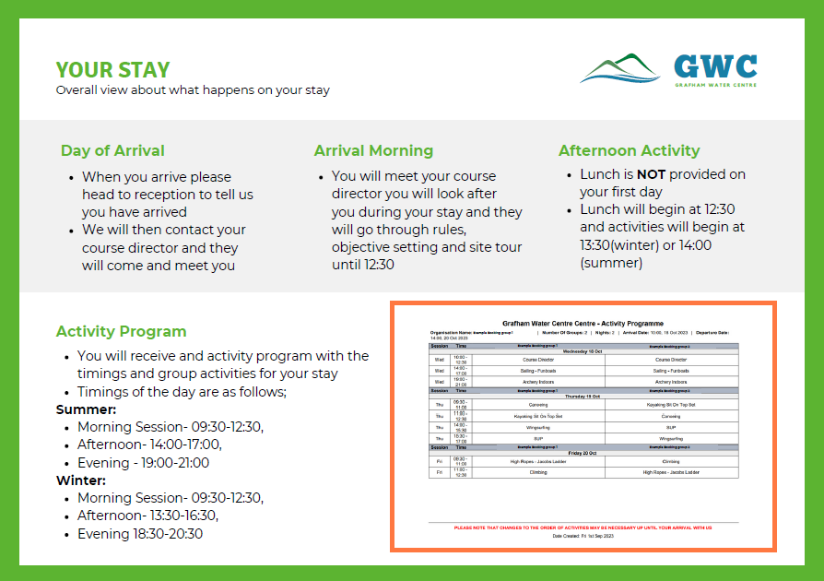
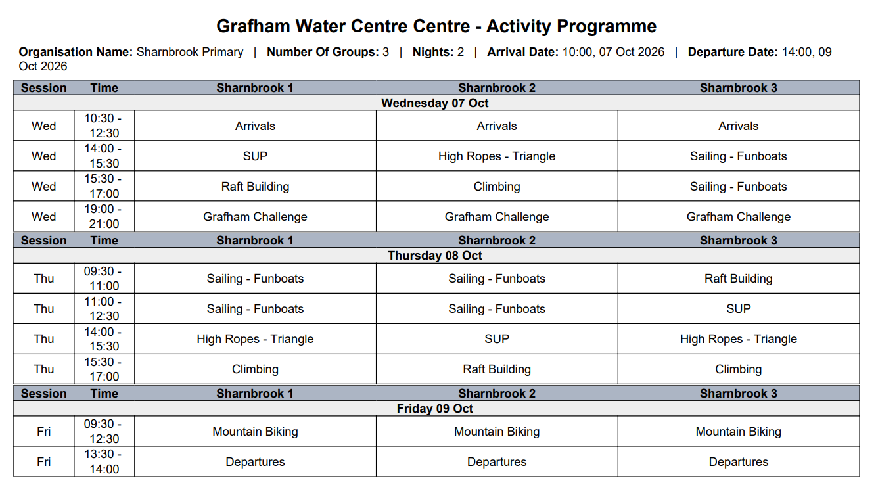

Slide 7
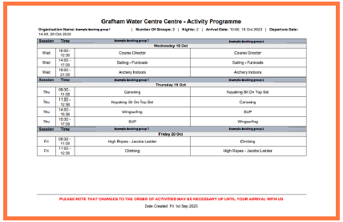

Slide 8
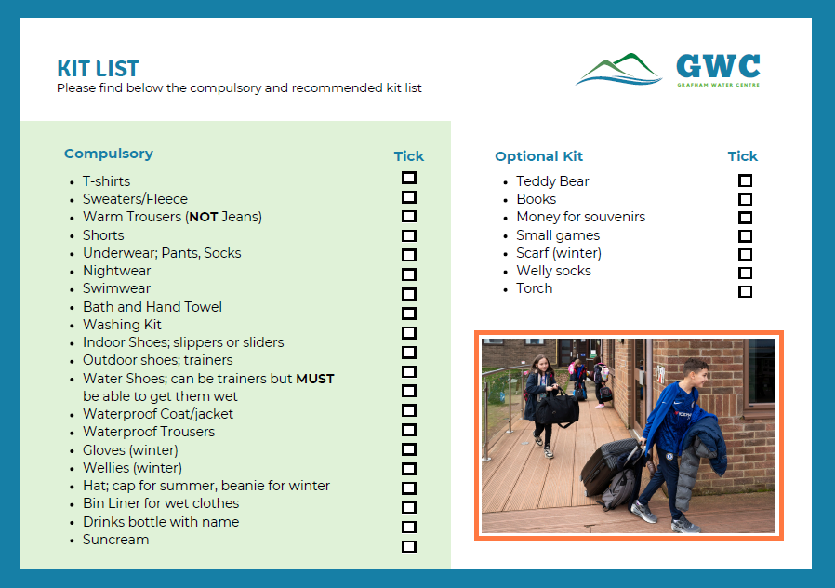

Slide 9
Important things to bring:
Well fitting water shoes are essential.
Please send you child with a pair of gloves for biking. It is often windy and their hands will get cold.

Slide 10
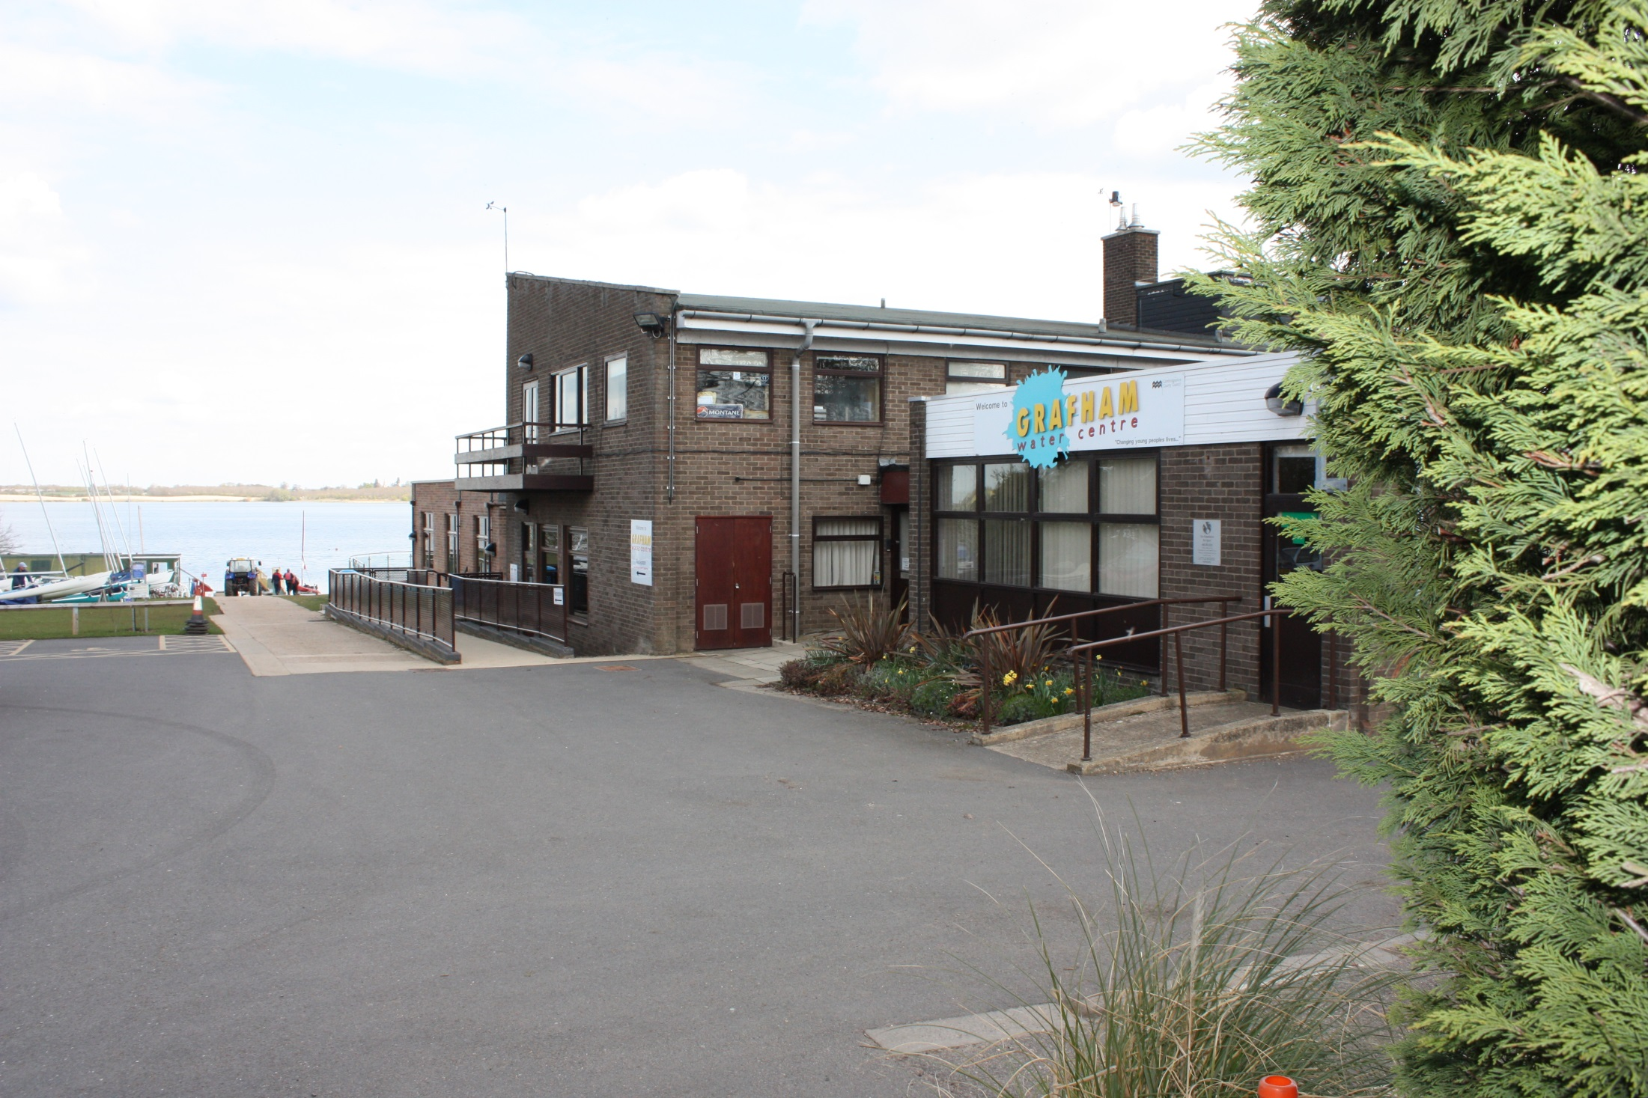

Grafham Water Centre

Slide 11
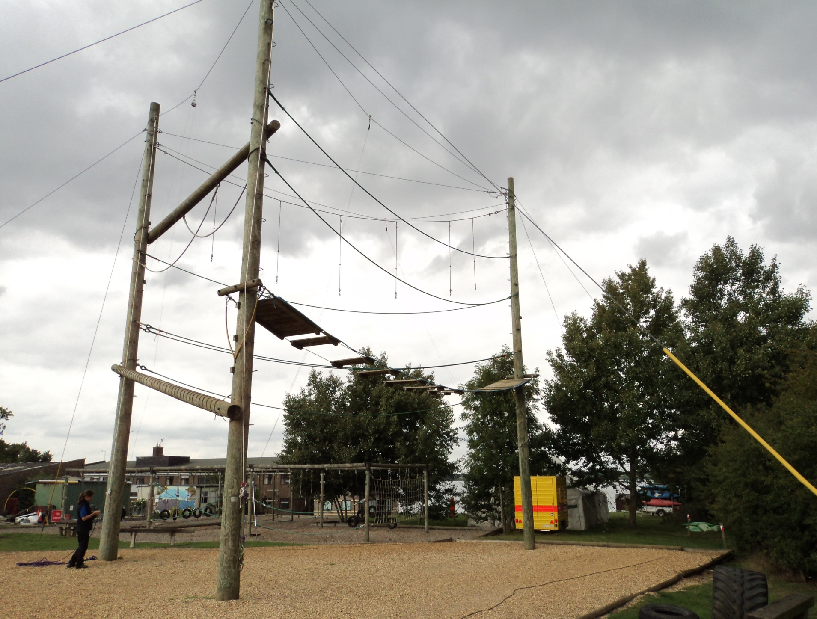
High Ropes

Slide 12
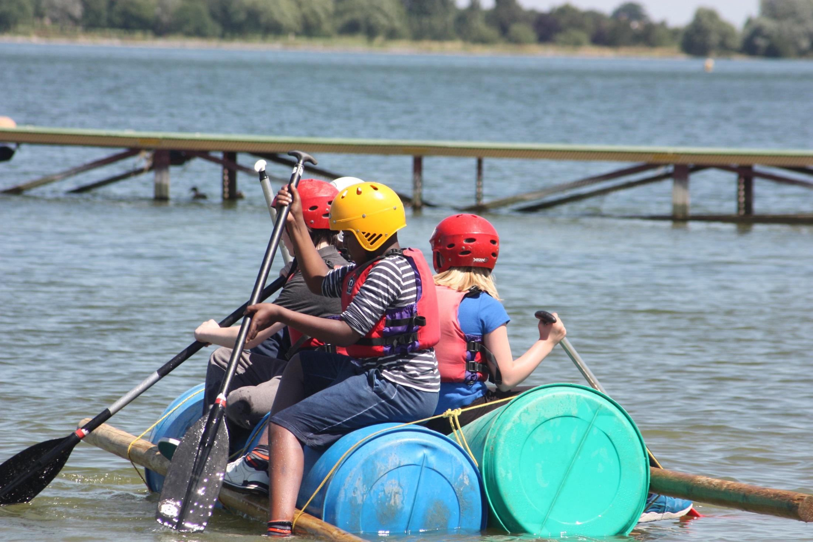
Raft Building

Slide 13
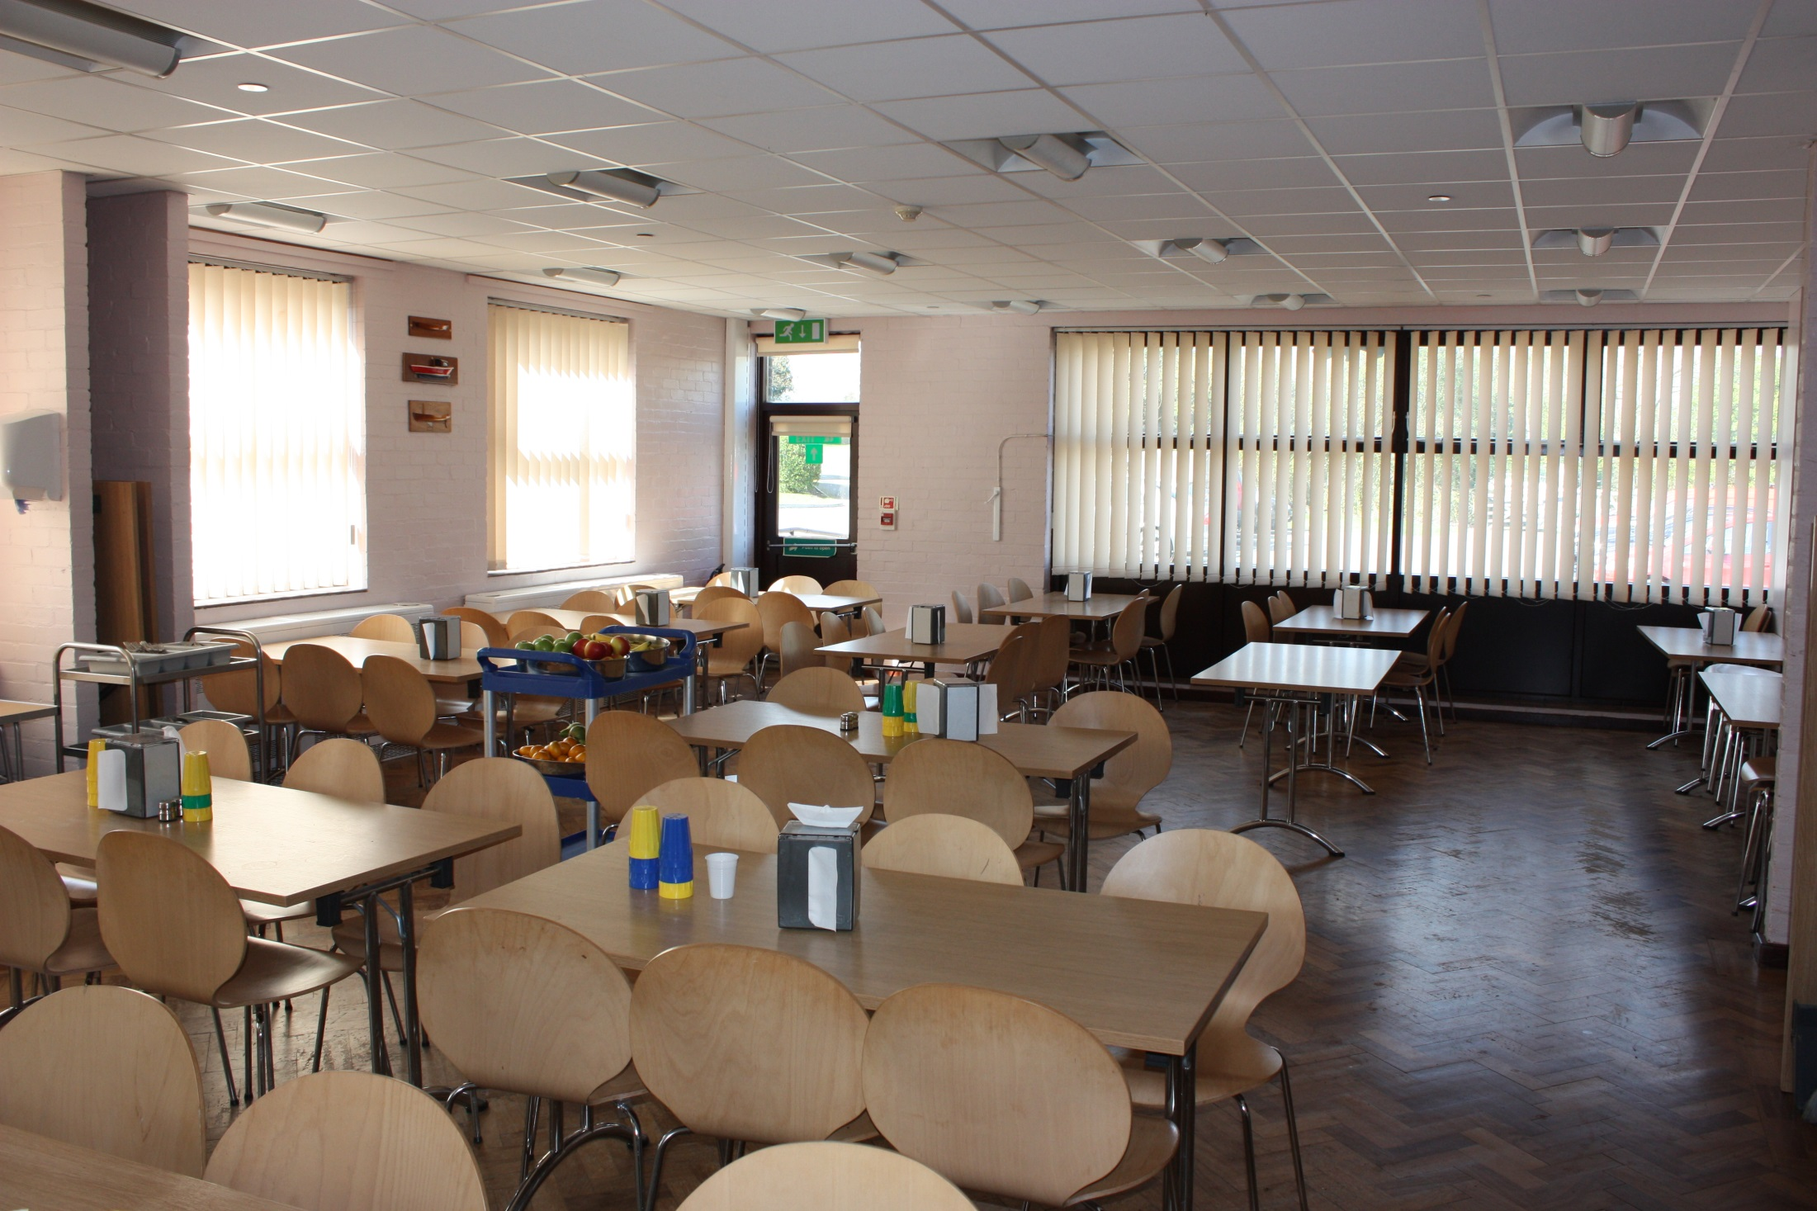
Dining Room

Slide 14
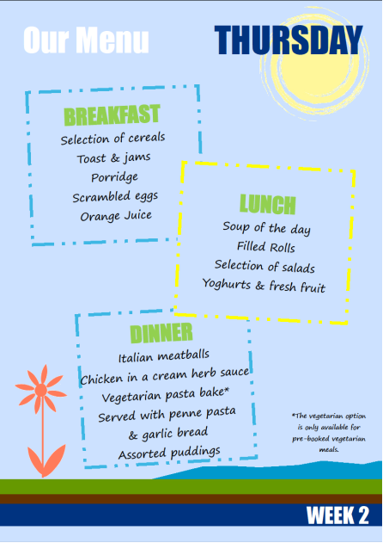
Grafham Water Centre
Facilities
Notes:
This is and example of one of our menu’s for a day at Grafham. These change each day during your stay.

Slide 15
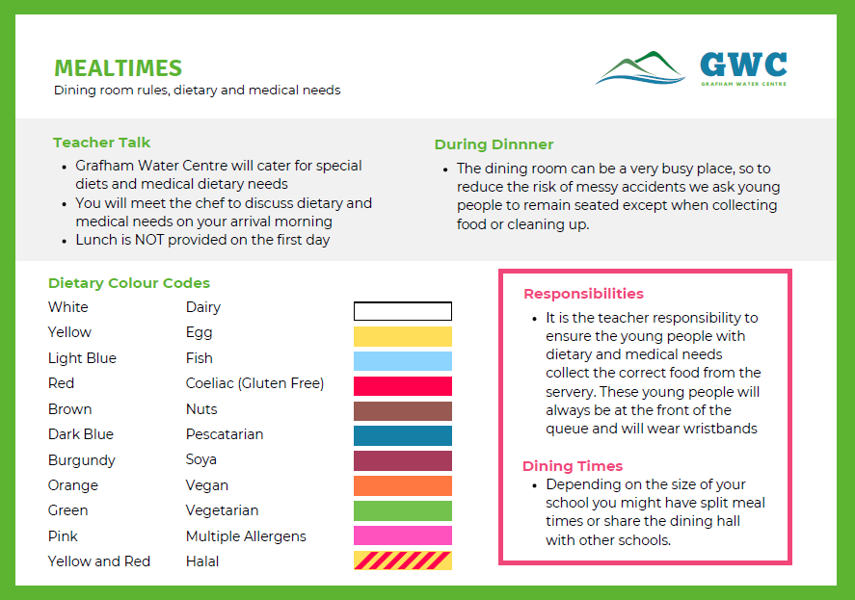

Slide 16
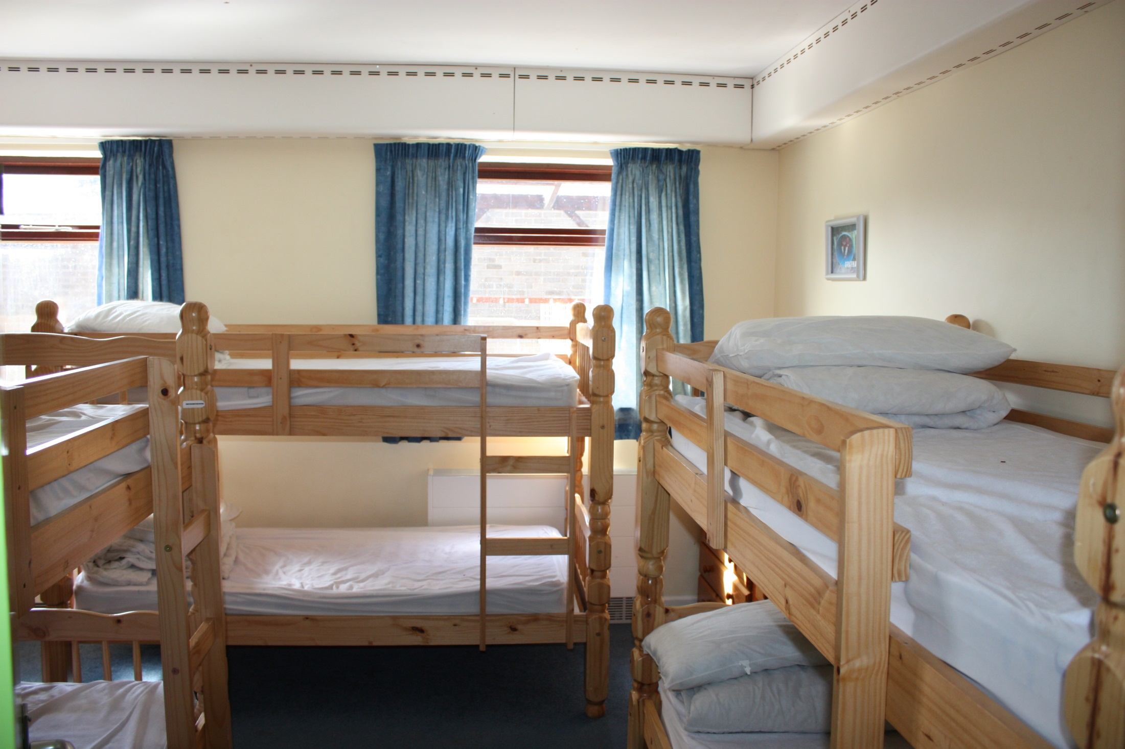
Bedrooms

Slide 17
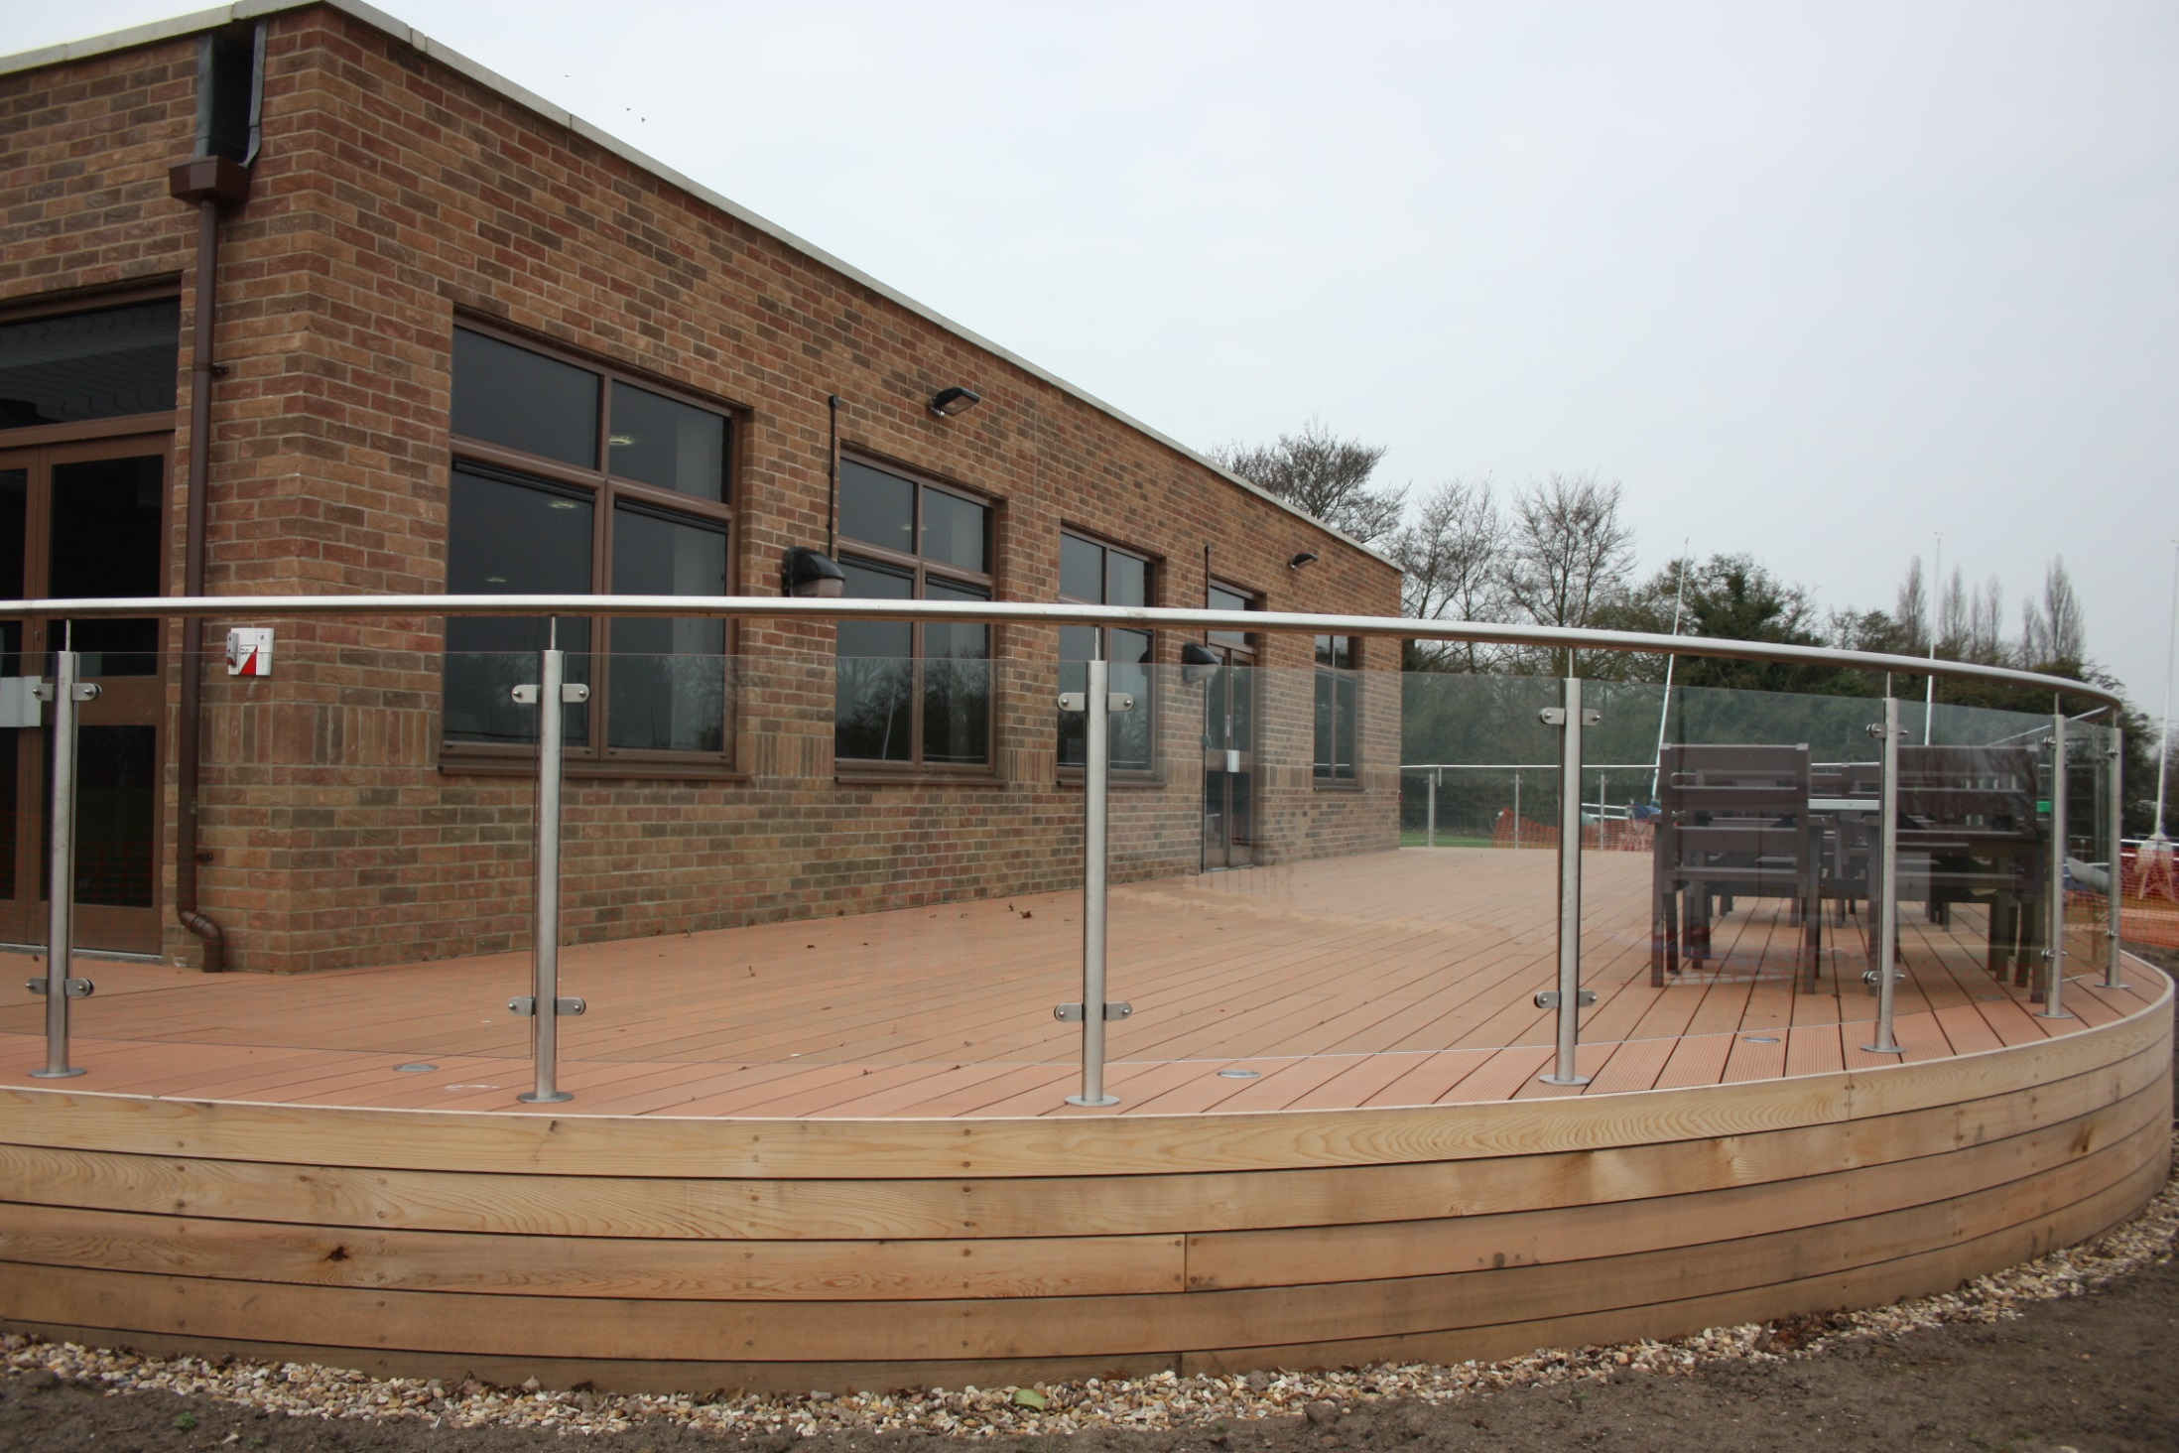
Grounds

Slide 18
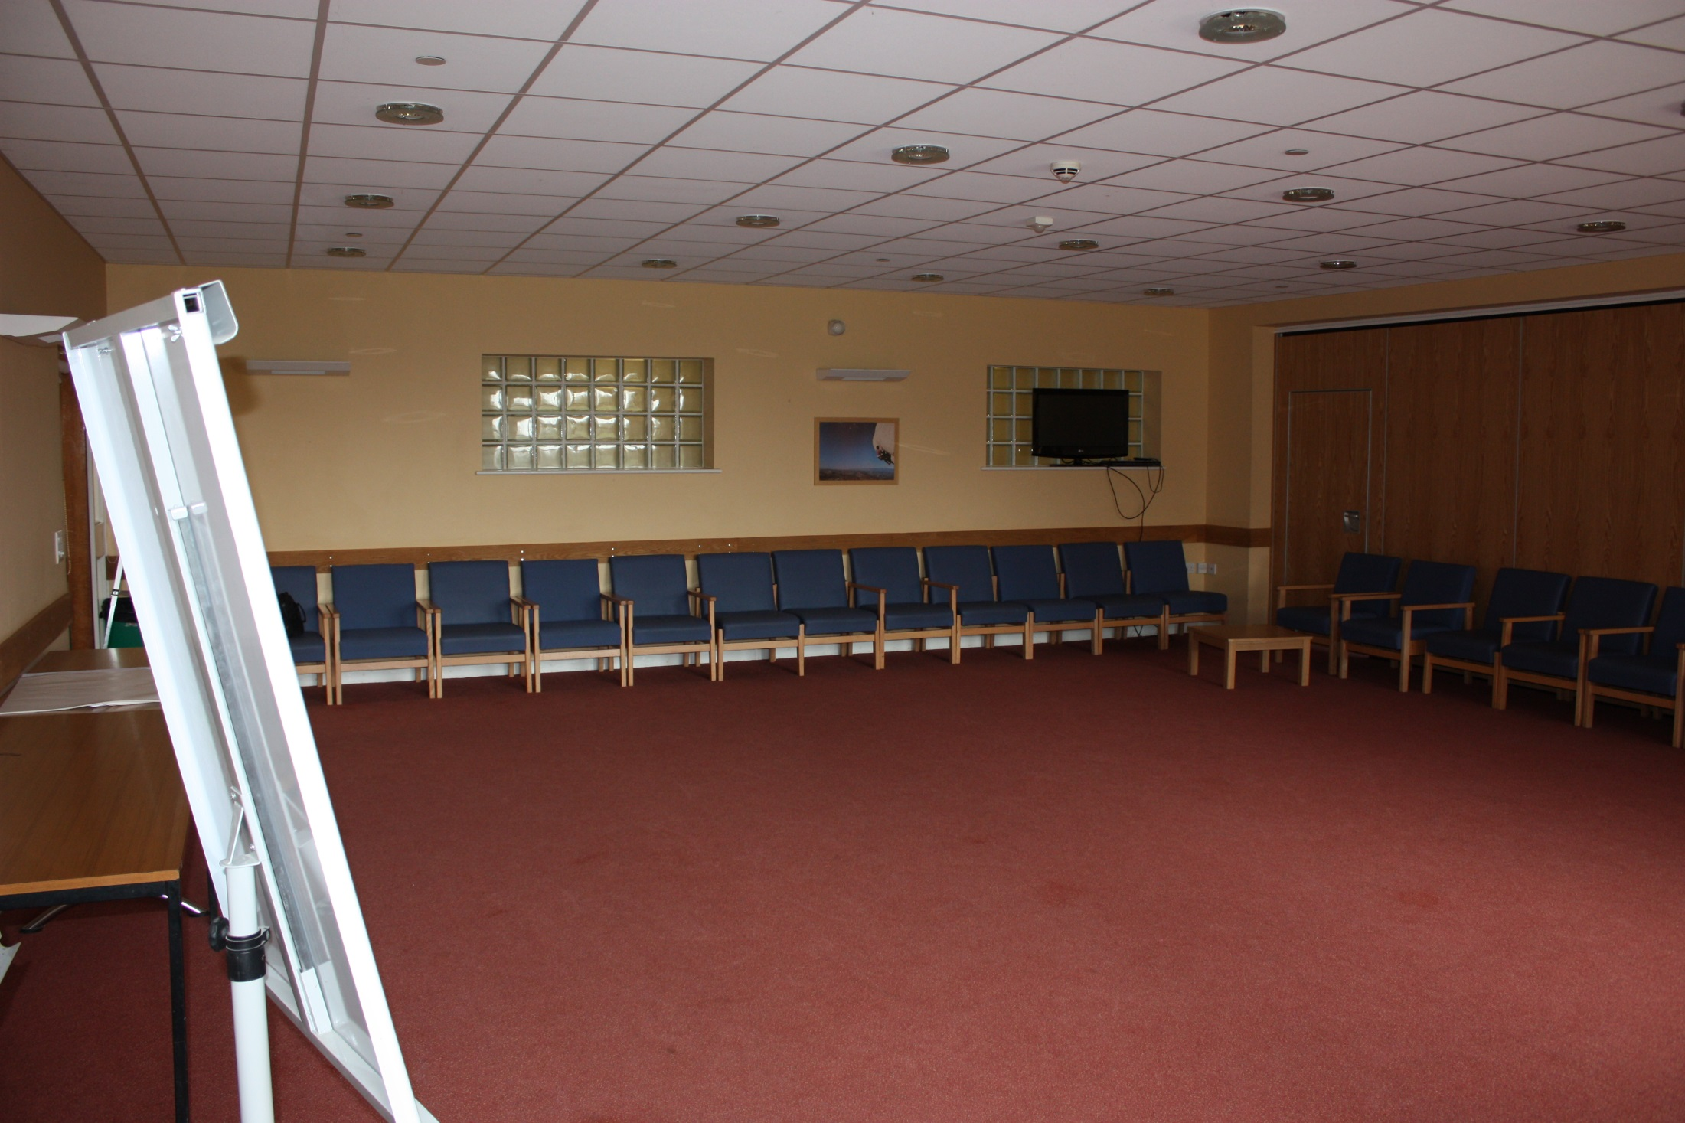
Lounges

Slide 19
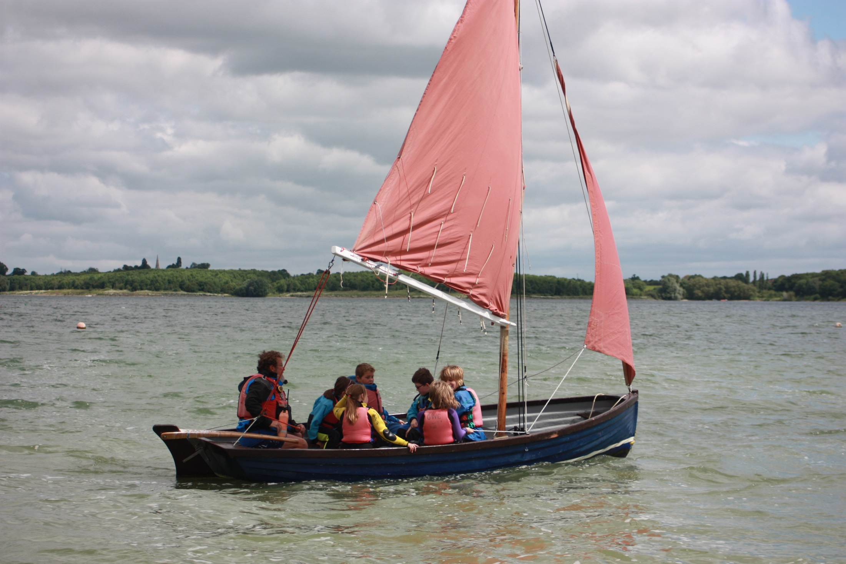
Whammel Sailing

Slide 20
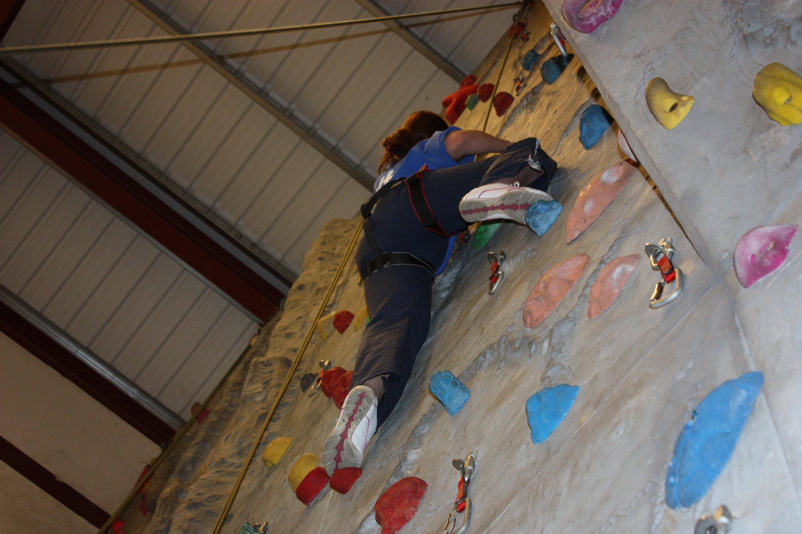
Climbing

Slide 21
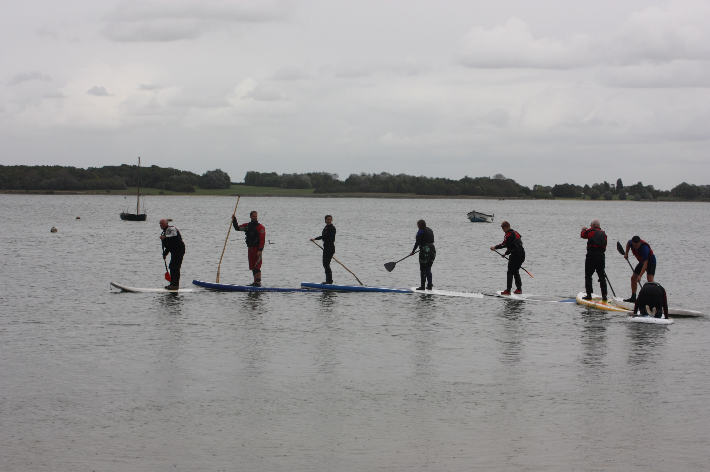
Stand Up Paddle Boarding

Slide 22
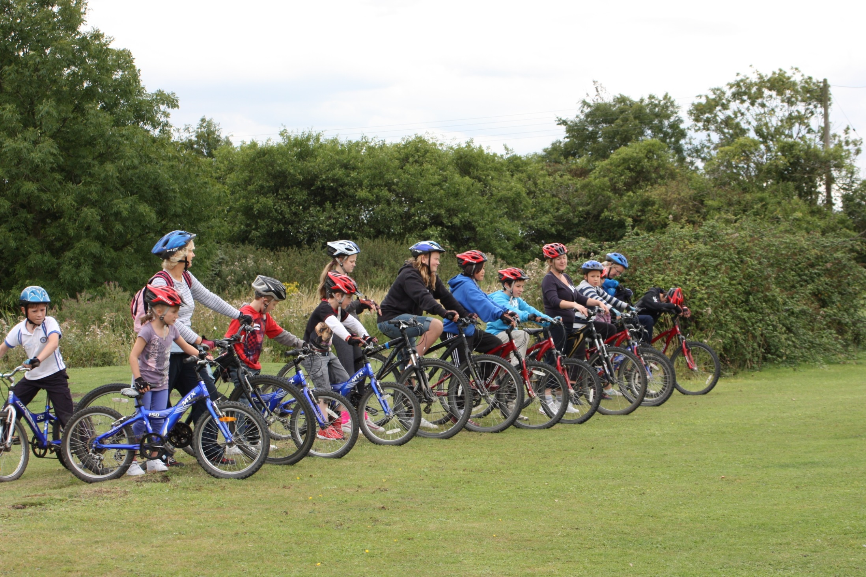
Mountain biking

Slide 23
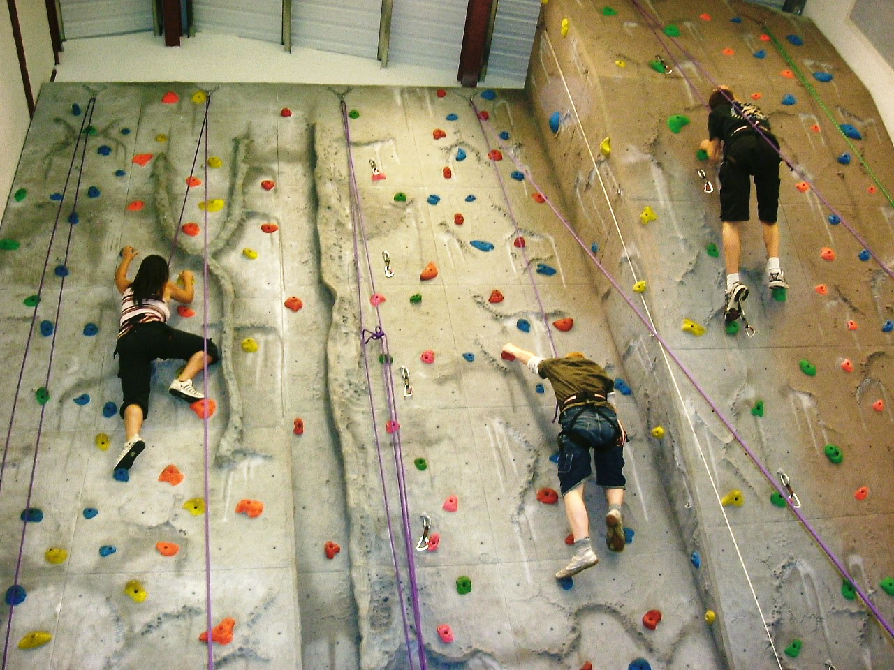
Climbing

Slide 24


Slide 25
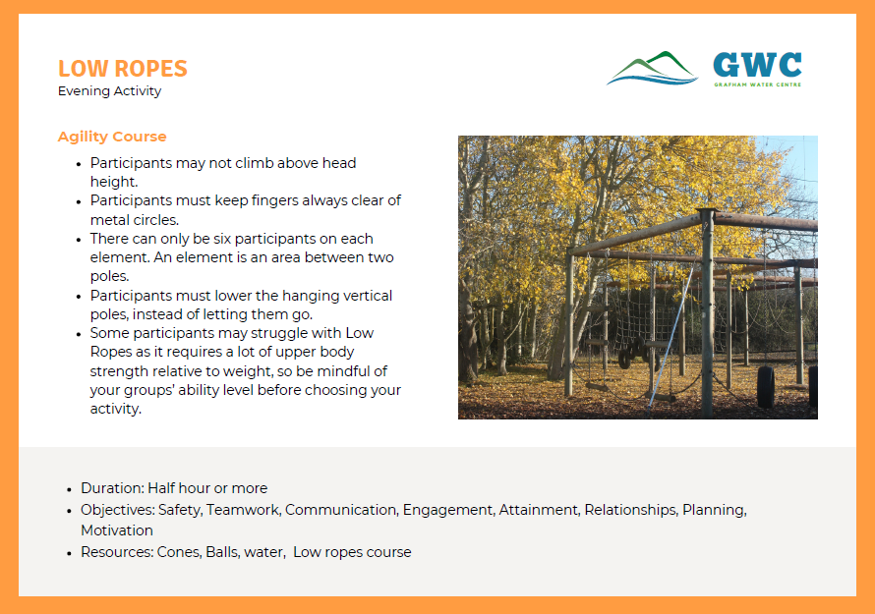

Slide 26
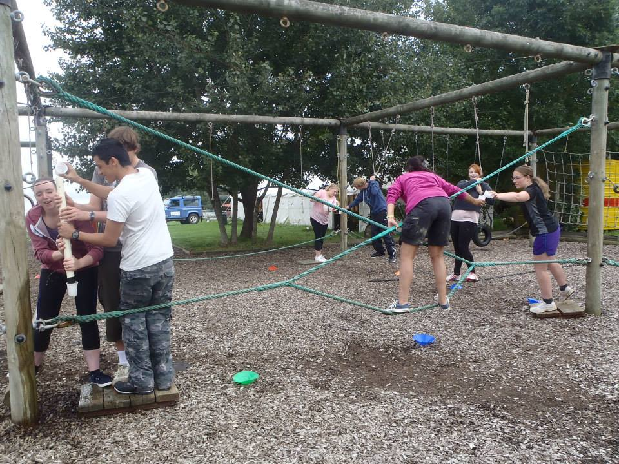
Low Ropes

Slide 27
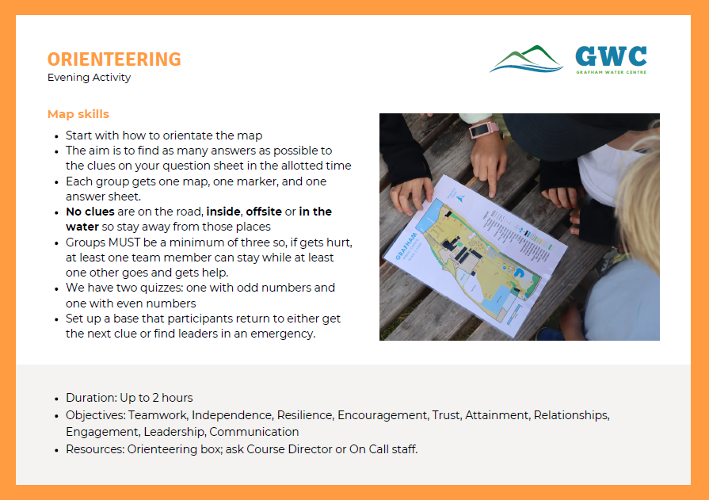

Slide 28
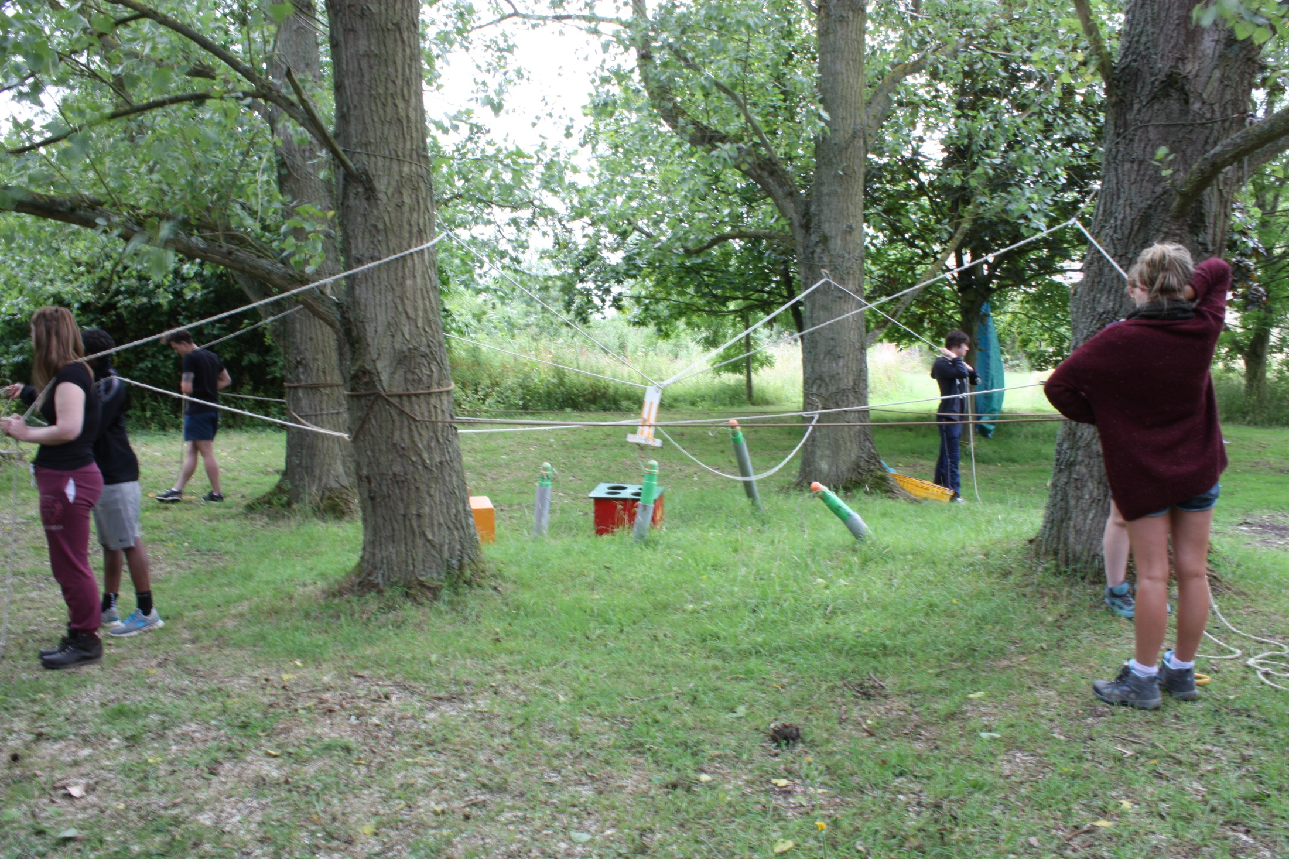
Problem Solving

Slide 29
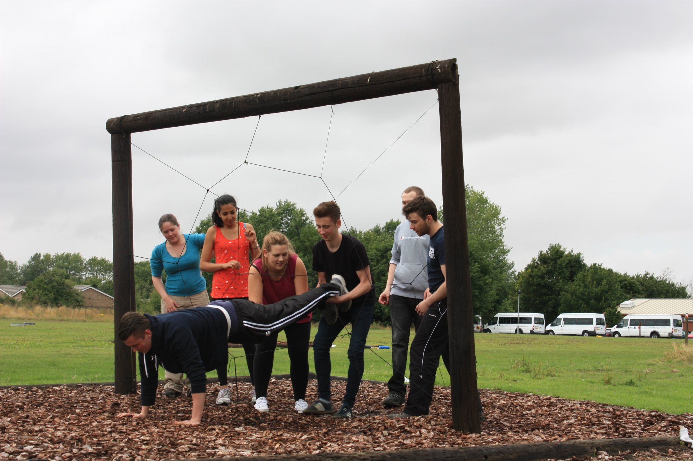
Problem Solving

Slide 30
“Children are now readily working with
children that they tried to avoid at the
beginning of the course”.
Teacher Kingsfield School
“Instructors all set high expectations and children were given plenty of opportunities to reflect on the performances”. Teacher Kingsfield School
Grafham Water Centre
Quote’s
“I really liked Grafham water and think that it is a privilege we can go there”.
Student Brooklands primary school
“Thank you for another fantastic stay. The children have gained and achieved so much from being
here and have had an amazing time! The leaders have made everything easy and have communicated effectively with staff. They were also great fun and brought out the best in each and every child”.
Teacher Brampton Village Primary School
“The instructors made an excellent contribution to helping our children overcome their fears. This was a challenging group of children that the instructors worked with really well”.
Teacher Almond Hill School
Notes:
Above are some quotes from some of last years school groups

Slide 31
Any questions ?
Grafham Water Centre
Questions ?
Notes:
Any questions ??

