Slide 1



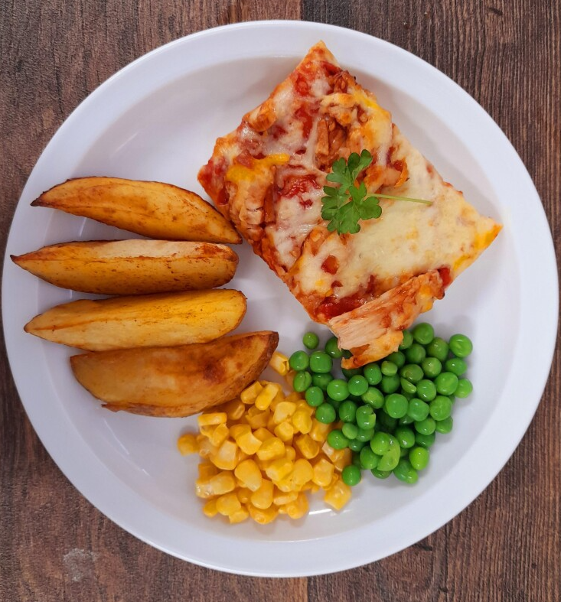

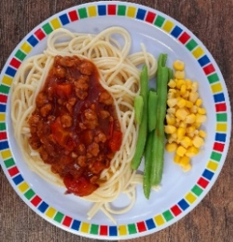

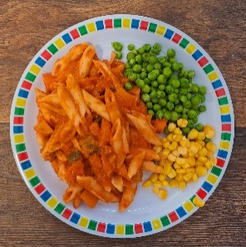
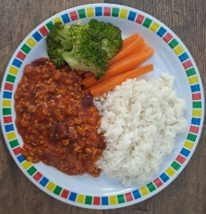

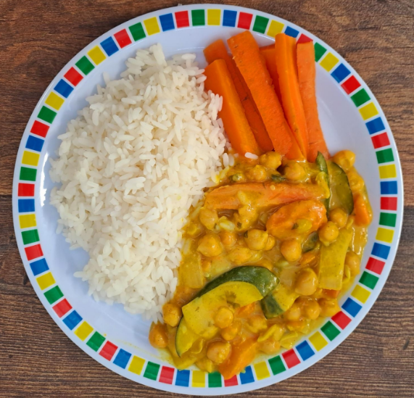
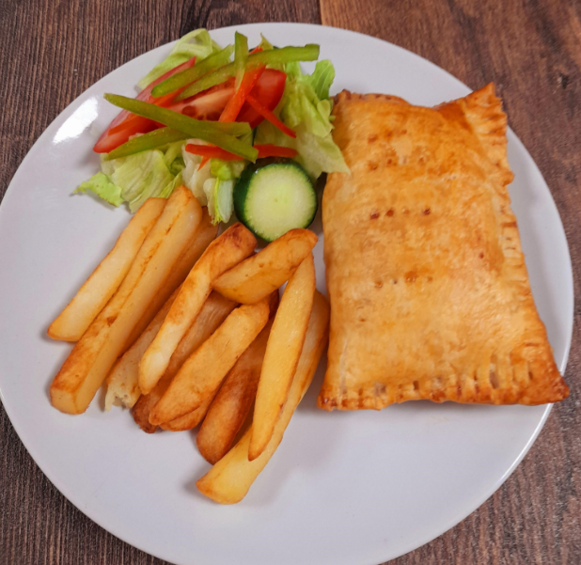





Spring Summer 2025
Macaroni Cheese
BBQ Chicken Pizza With Wedges
Roast Pork with Roast Potatoes and Gravy
Spaghetti Bolognaise
Pollock Fish Fingers with Chips & Tomato Sauce
01/09/2025
22/09/2025
13/10/2025
Tomato and Lentil Pasta
NEW Mild Mexican Chilli with Rice
Roasted Quorn with Roast Potatoes and Gravy
NEW Chefs Special Chickpea Curry with Rice
Cheese & Bean Pasty with Chips & Tomato Sauce
Apple Flapjack
Summer Lemon Cake
Fruit Platter
Savoury Cheese Scone
Strawberry Jelly with Mandarins

Slide 2
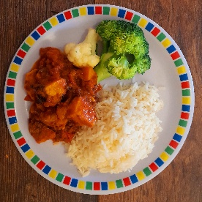


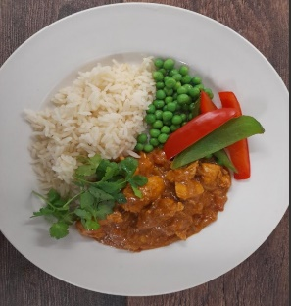

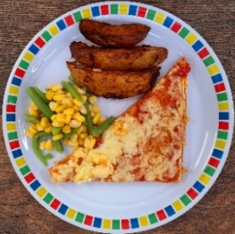
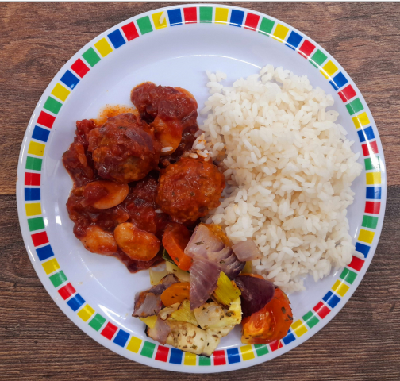
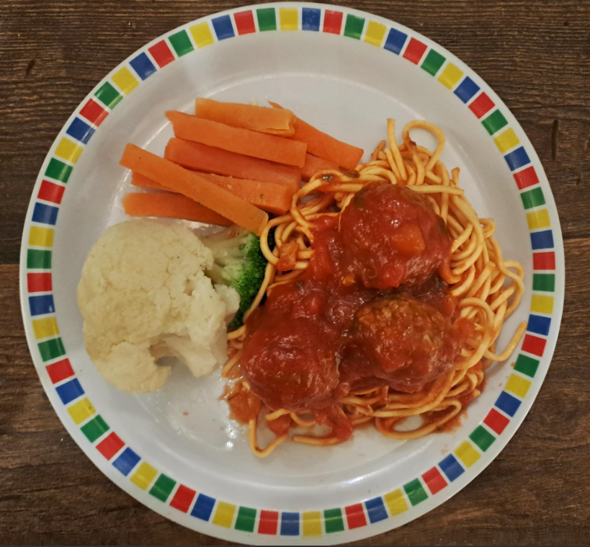
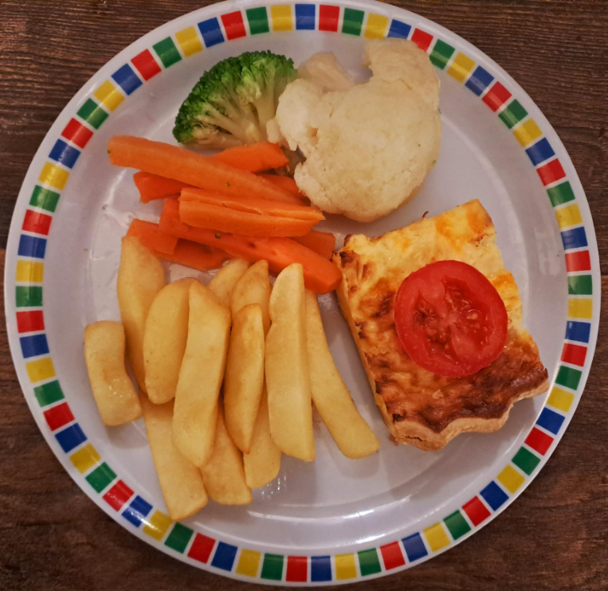
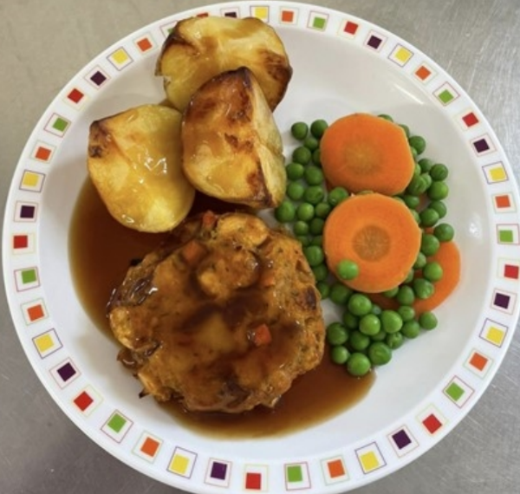




Spring Summer 2025
Lentil and Sweet Potato Curry with Rice
Pork Hot Dog with Wedges & Tomato Sauce
Roast Chicken with Stuffing, Roast Potatoes and Gravy
Chef Special Chicken and Chickpea Korma with Rice
Battered Fish with Chips & Tomato Sauce
08/09/2025
29/09/2025
20/10/2025
Cheese and Tomato Pizza with Wedges
Vegan Hot Dog with Wedges & Tomato Sauce
Vegetable Soya Roast with Stuffing, Roast Potatoes and Gravy
Spaghetti and Meatballs
Cheese and Tomato Quiche with Chips
Iced Vanilla Sponge
NEW Strawberry and Apple Crumble with Custard
Freshly Chopped Fruit Salad
Peaches and Ice Cream
Vanilla Shortbread

Slide 3

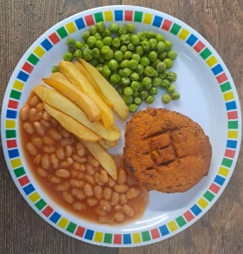
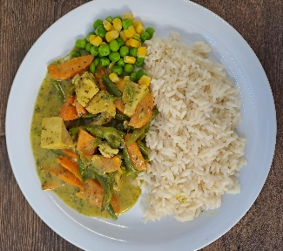

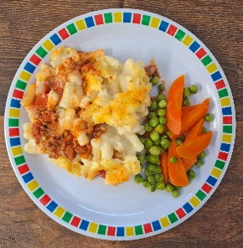


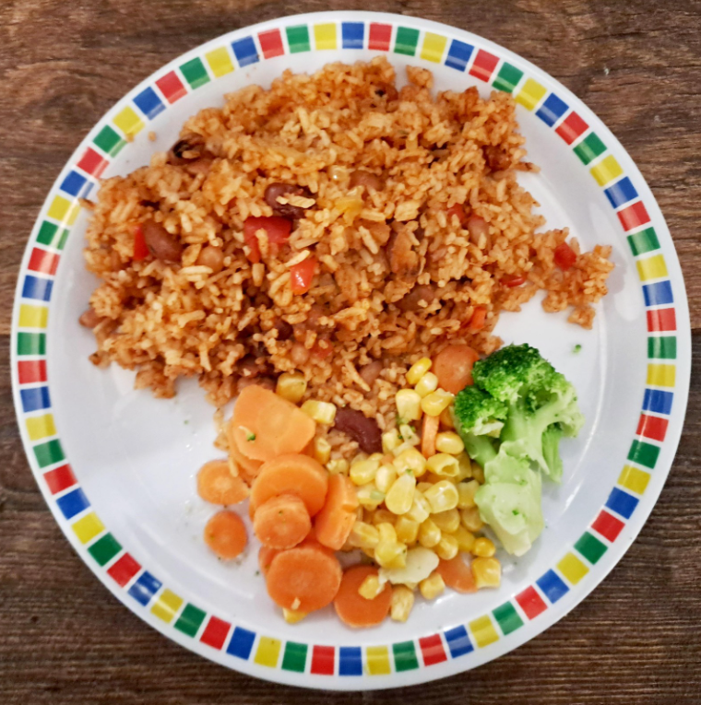

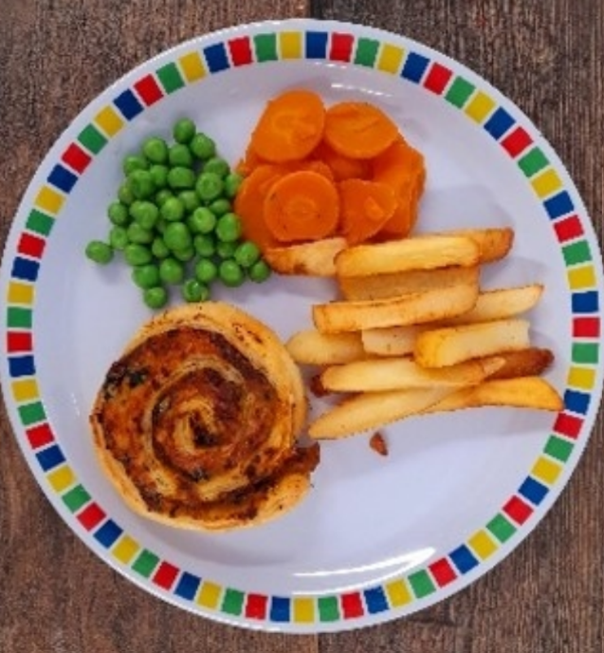

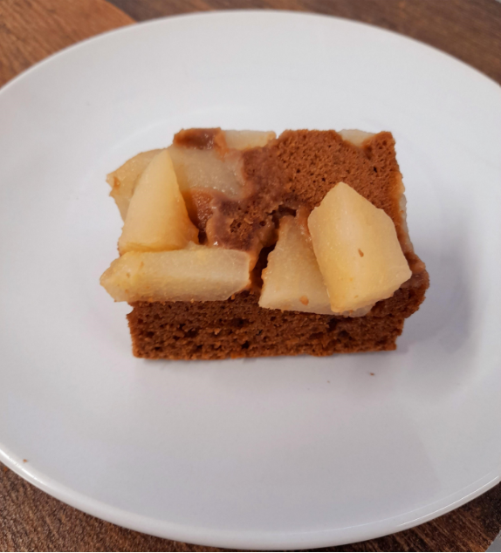



Spring Summer 2025
Smoky Bean Burger with Potato Wedges
New Green Thai Chicken Curry with Rice
Roast Turkey with Stuffing, Roast Potatoes and Gravy
NEW Greek Macaroni Pastitsio with Greek Salad and Tzatziki
Breaded Fish and Chips
Classic Vegan Bolognaise
NEW Chefs Special Five Bean Jollof Rice
Veg Wellington with Stuffing, Roast Potatoes and Gravy
Spinach and Cheese Whirl with Rice, Greek Salad and Tzatziki
All Day Vegan Breakfast
Pear and Cocoa Upside Down Cake
Cheese and Crackers
Fruit Medley
Jam and Coconut Sponge
Oaty Cookie

