Slide 1
Personal Social Health Economic and Emotional Development within this fits the Relationships Education

Slide 2
Contents
Sharnbrook Primary’s response to inappropriate play
Sharnbrook Primary’s response to the “Dead Game”
Relationship and Sex education at Sharnbrook Primary

Slide 3
Inappropriate Games – School’s Response
Talk to the individuals involved to understand what they are doing and why.
Explain to the children why the game is inappropriate.
Inform the parents of the children involved.
Where there is a wider learning point talk with the whole class.
Review practice.

Slide 4
What Happened last summer
Staff talked to the children to find out what the game was about.
They spoke to the children and parents of those they knew were involved.
All the children watched the Pantasaurus video and participated in a discussion about appropriate play.
Since coming back to school this has been revisited
Notes:
All the children in the Penguins watched the Pantosaurus video and participated in a discussion relating to this as soon Pre School staff were aware of the incident.
Since coming back to school this has been reinforced by the class teacher. These very important messages are built on year on year through the PSHE curriculum as well as any extra work that is done to response to class or individual needs.
All teachers who teach and look after the children have been made aware of the situation so they can be extra vigilant.
During our safeguarding training at the start of term we looked at all the all the different signs staff need to be aware of, the importance of safeguarding being everyone's responsibility and introduced the school focus of encouraging all children to speak out about things that they are not comfortable with.
Both EYFS and KS1 classrooms have been review and adapted to ensure that the children are clearly visible at all times.
Due to concerns raised and requests for information about how to talk to children about this topic, the school in the process of organising a meeting for parents.

Slide 5
The staff looking after the children have been made aware of the game so they can be vigilant.
EYFS and KS1 classrooms have been reviewed and adapted to ensure that children are clearly visible.
During our safeguarding training we looked at different signs staff need to be aware of, the importance of safeguarding being everyone's responsibility and introduced the school focus of encouraging all children to speak out about things that they are not comfortable with.

Slide 6
We are trying to teach the children about appropriate and inappropriate play so they can apply it to different contexts as well as banning the game.
By teaching the pupils proper names for body parts this avoids confusion.
Support on how to talk to your child - https://www.nspcc.org.uk/keeping-children-safe/support-for-parents/pants-underwear-rule/pants-how-to-answer-questions/

Slide 7
Education, Relationships and Sex Education and Health Education
From Department of Education
By the end of Primary school

Slide 8
Families and People who care for me.
Pupils should know
• that families are important for children growing up because they can give love, security and stability.
• the characteristics of healthy family life, commitment to each other, including in times of difficulty, protection and care for children and other family members, the importance of spending time together and sharing each other’s lives.
• that others’ families, either in school or in the wider world, sometimes look different from their family, but that they should respect those differences and know that other children’s families are also characterised by love and care.

Slide 9
Respectful Relationships
Pupils should know
• the importance of respecting others, even when they are very different from them (for example, physically, in character, personality or backgrounds), or make different choices or have different preferences or beliefs.
• practical steps they can take in a range of different contexts to improve or support respectful relationships.
• the conventions of courtesy and manners.
• the importance of self-respect and how this links to their own happiness.
• that in school and in wider society they can expect to be treated with respect by others, and that in turn they should show due respect to others, including those in positions of authority.

Slide 10
Caring Friendships
Pupils should know
• how important friendships are in making us feel happy and secure, and how people choose and make friends.
• the characteristics of friendships, including mutual respect, truthfulness, trustworthiness, loyalty, kindness, generosity, trust, sharing interests and experiences and support with problems and difficulties.
• that healthy friendships are positive and welcoming towards others, and do not make others feel lonely or excluded.
• that most friendships have ups and downs, and that these can often be worked through so that the friendship is repaired or even strengthened, and that resorting to violence is never right.
• how to recognise who to trust and who not to trust, how to judge when a friendship is making them feel unhappy or uncomfortable, managing conflict, how to manage these situations and how to seek help or advice from others, if needed.
about different types of bullying (including cyberbullying), the impact of bullying, responsibilities of bystanders (primarily reporting bullying to an adult) and how to get help.
• what a stereotype is, and how stereotypes can be unfair, negative or destructive.
• the importance of permission-seeking and giving in relationships with friends, peers and adults.

Slide 11
Online Relationships and Being Safe
Online relationships Pupils should know
• that people sometimes behave differently online, including by pretending to be someone they are not.
• that the same principles apply to online relationships as to face-to-face relationships, including the importance of respect for others online including when we are anonymous.
• the rules and principles for keeping safe online, how to recognise risks, harmful content and contact, and how to report them.
• how to critically consider their online friendships and sources of information including awareness of the risks associated with people they have never met.
• how information and data is shared and used online.
Being safe Pupils should know
• what sorts of boundaries are appropriate in friendships with peers and others (including in a digital context).
• about the concept of privacy and the implications of it for both children and adults; including that it is not always right to keep secrets if they relate to being safe.
• that each person’s body belongs to them, and the differences between appropriate and inappropriate or unsafe physical, and other, contact.
• how to respond safely and appropriately to adults they may encounter (in all contexts, including online) whom they do not know.
• how to recognise and report feelings of being unsafe or feeling bad about any adult.
• how to ask for advice or help for themselves or others, and to keep trying until they are heard.
• how to report concerns or abuse, and the vocabulary and confidence needed to do so.
• where to get advice e.g. family, school and/or other sources.

Slide 12
Robins Class coverage in the Autumn Term
Families and friendships Understand what a family is and what it means to them. Understanding about similarities and differences between ourselves and others Who cares and looks after you. Who to ask for help | Safe relationships Respecting ourselves and others Naming and recognising different feelings. Seeking help from trusted adults should they need to Listening skills (taking turns). How to use your voice and ask for help- link to consent Saying ‘stop I don’t like it’ – link to consent. Identifying our emotions and how we are feeling | Respecting ourselves and others Self-confidence and how to feel good about self- success. Understand how to adjust behaviours to different situations Using your voice for help Or stop I don’t like it Trash can power. kindness

Slide 13
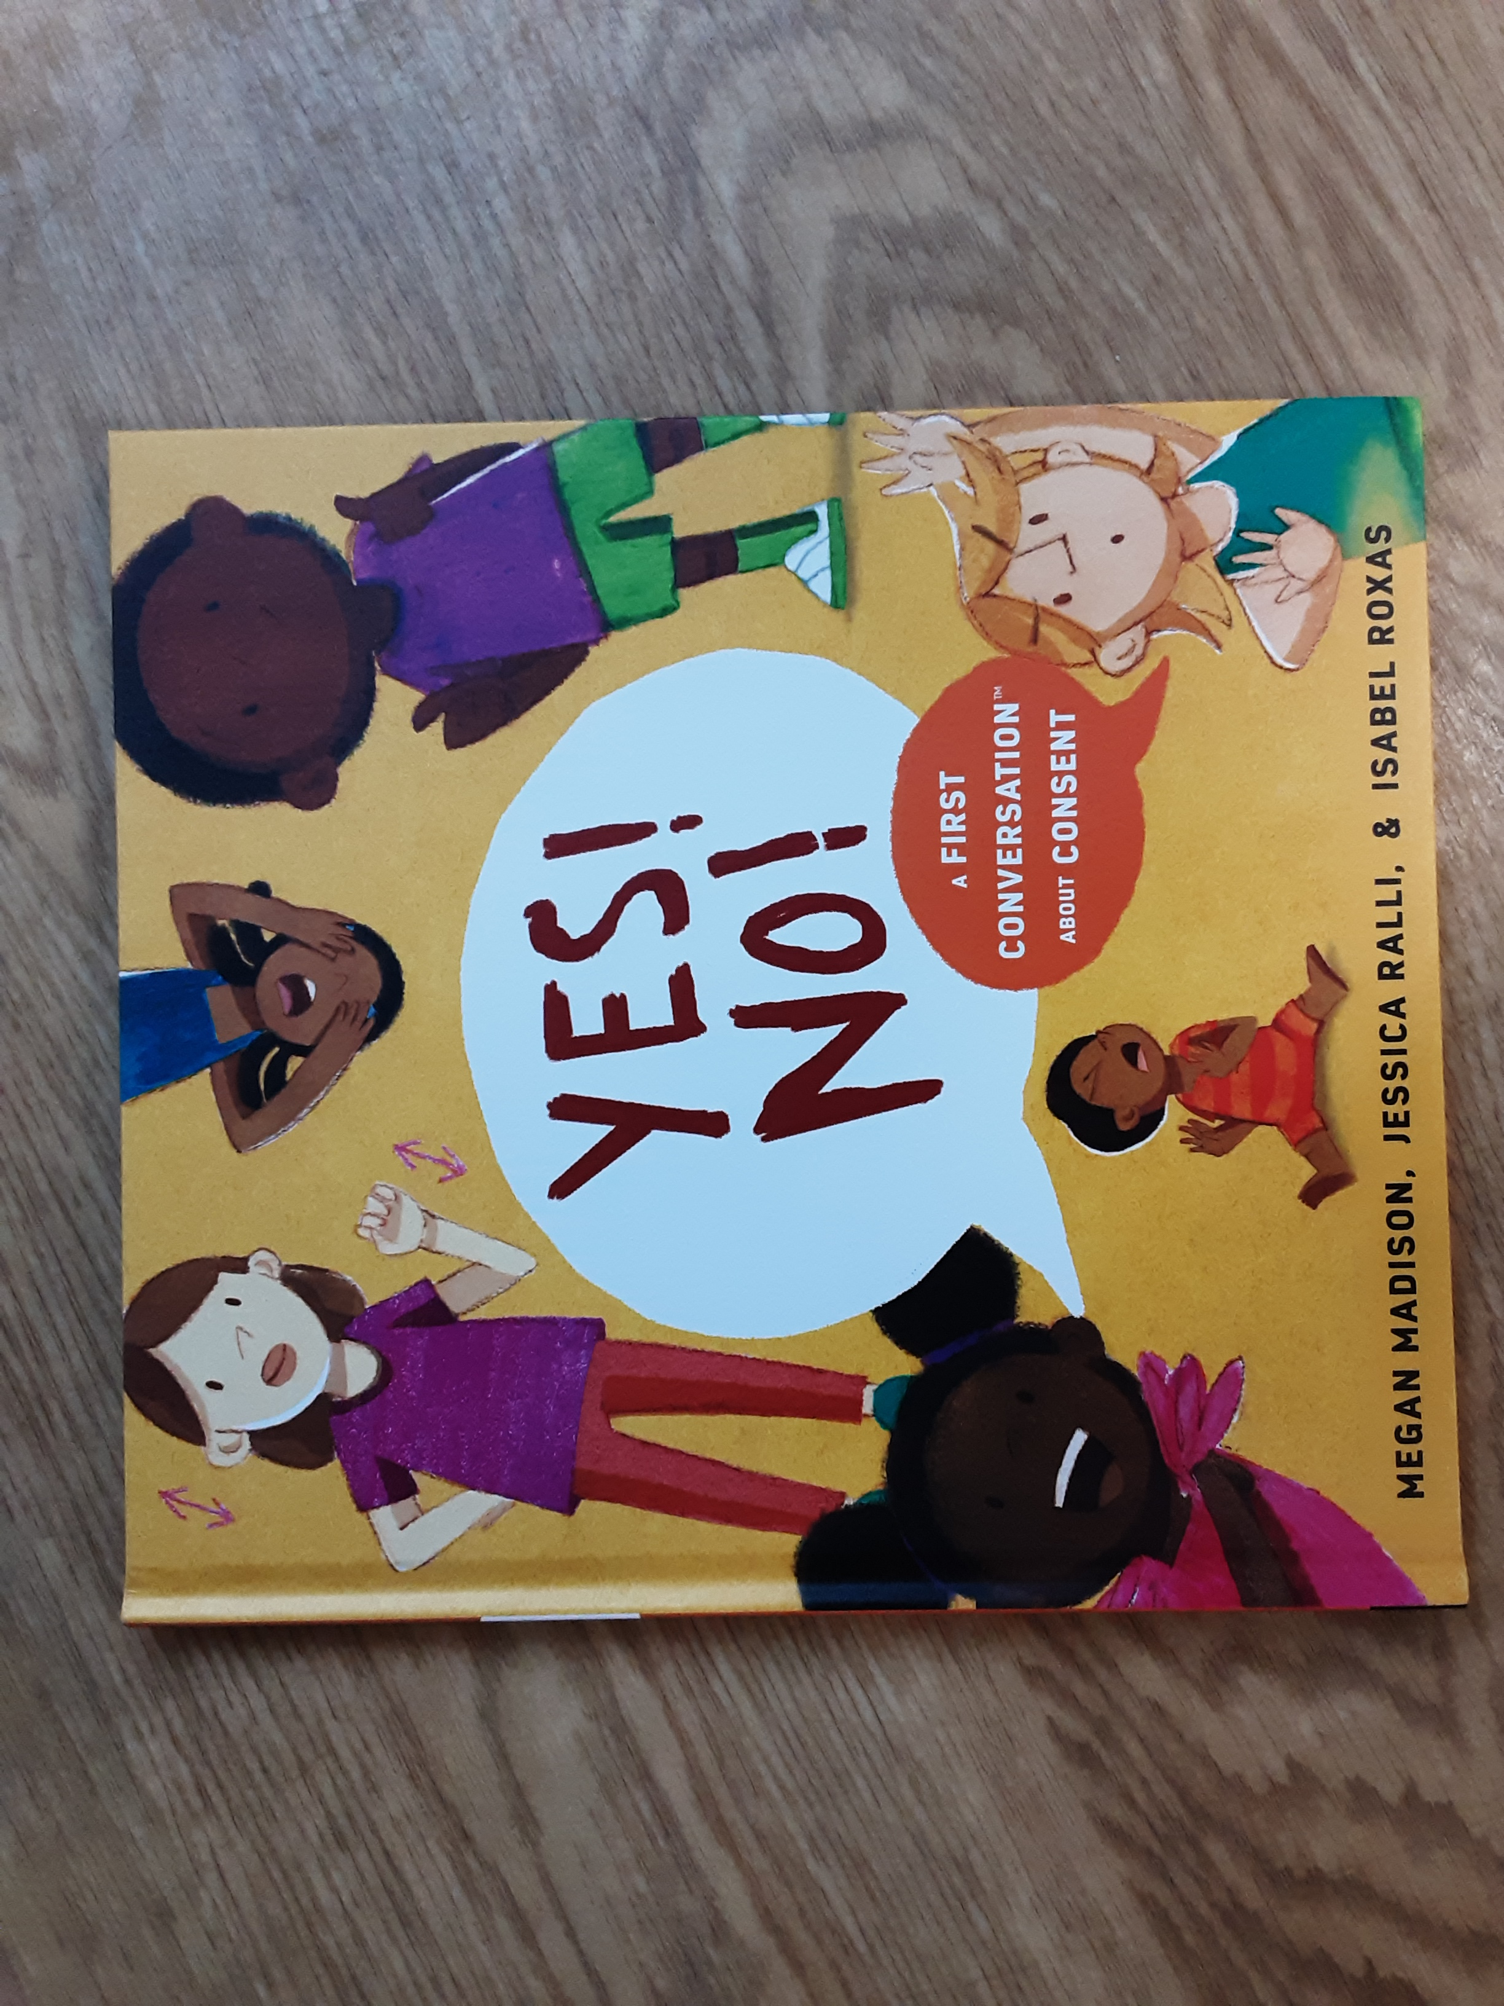
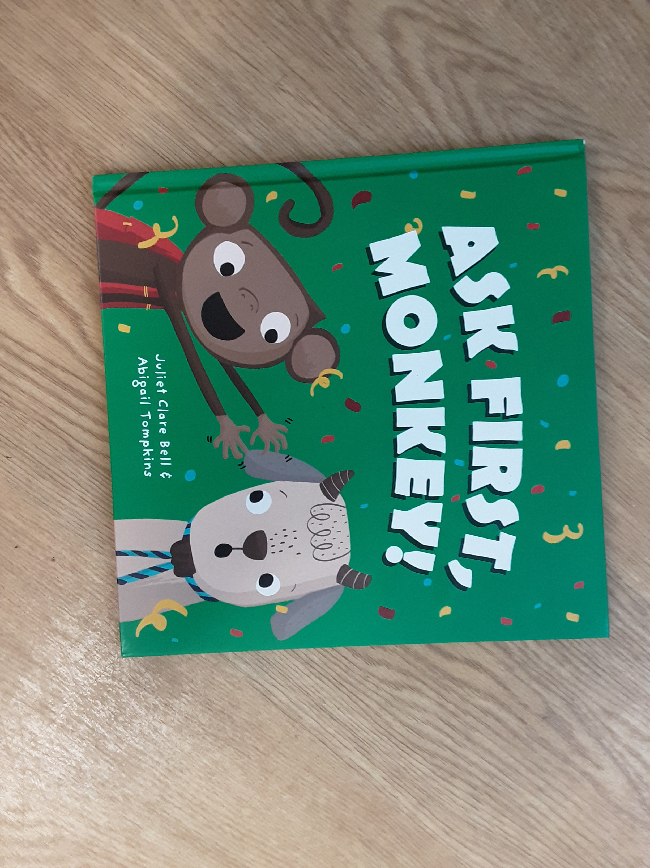
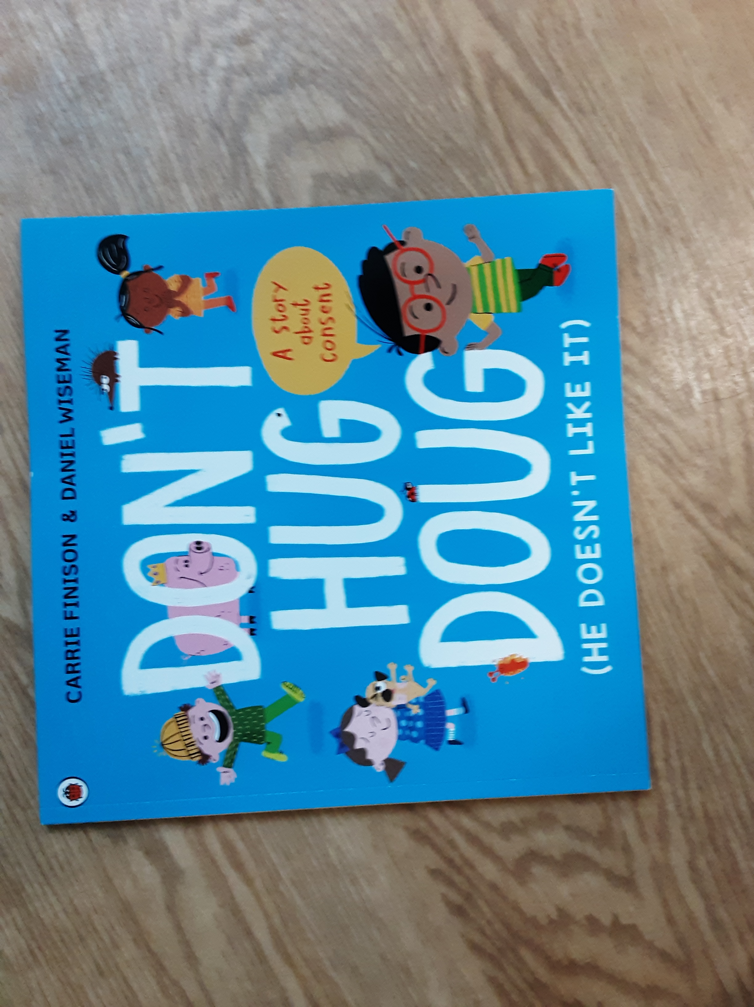
Consent
Using our voices to say ‘stop I don’t like it!
Encouraging children to ask for help.

Slide 14
Robins Class
Coverage in the Spring Term
Belonging to a community Talk about own and others’ behaviour and its consequences. Understand how to work as a group and understand what rules are Turn taking School rules | Media literacy and digital resilience Understanding that a range of technology is used in places such as homes and schools Passwords Personal details Asking permission Who to trust if you need help | Money and work Jobs in familiar environments such as their family and their school Perseverance with own challenges Car safety Water safety

Slide 15
Robins Class
Coverage in the Summer Term
Physical health and Mental wellbeing Understanding basic hygiene including dressing and going to the toilet Growth mindset Looking after ourselves – safety recap- road safety Who to trust. | Growing and changing Understanding good practices regarding sleep, exercise, eating and hygiene help with healthy growth Understand the need for safety when tackling new challenges. Considering and managing relevant risks | Keeping safe Understanding good practices regarding sleep, exercise, eating and hygiene help with healthy growth Sun safety Coping with change- death Change of class Worries and how to help themselves

Slide 16
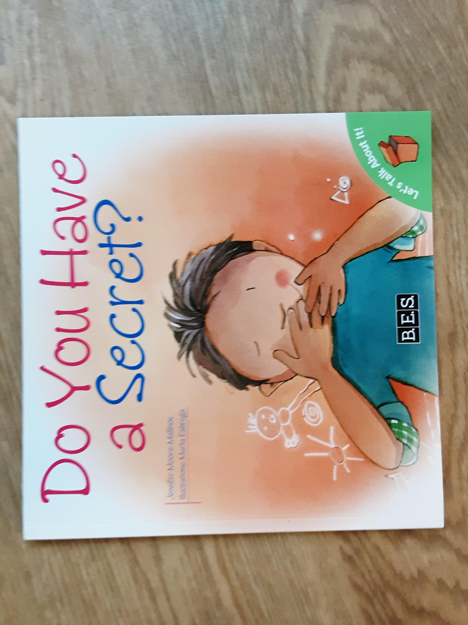

Some of the books we use.
Using a big voice to say ‘no’.

Slide 17

https://www.youtube.com/watch?v=u-m-gpG1mTU

Slide 18
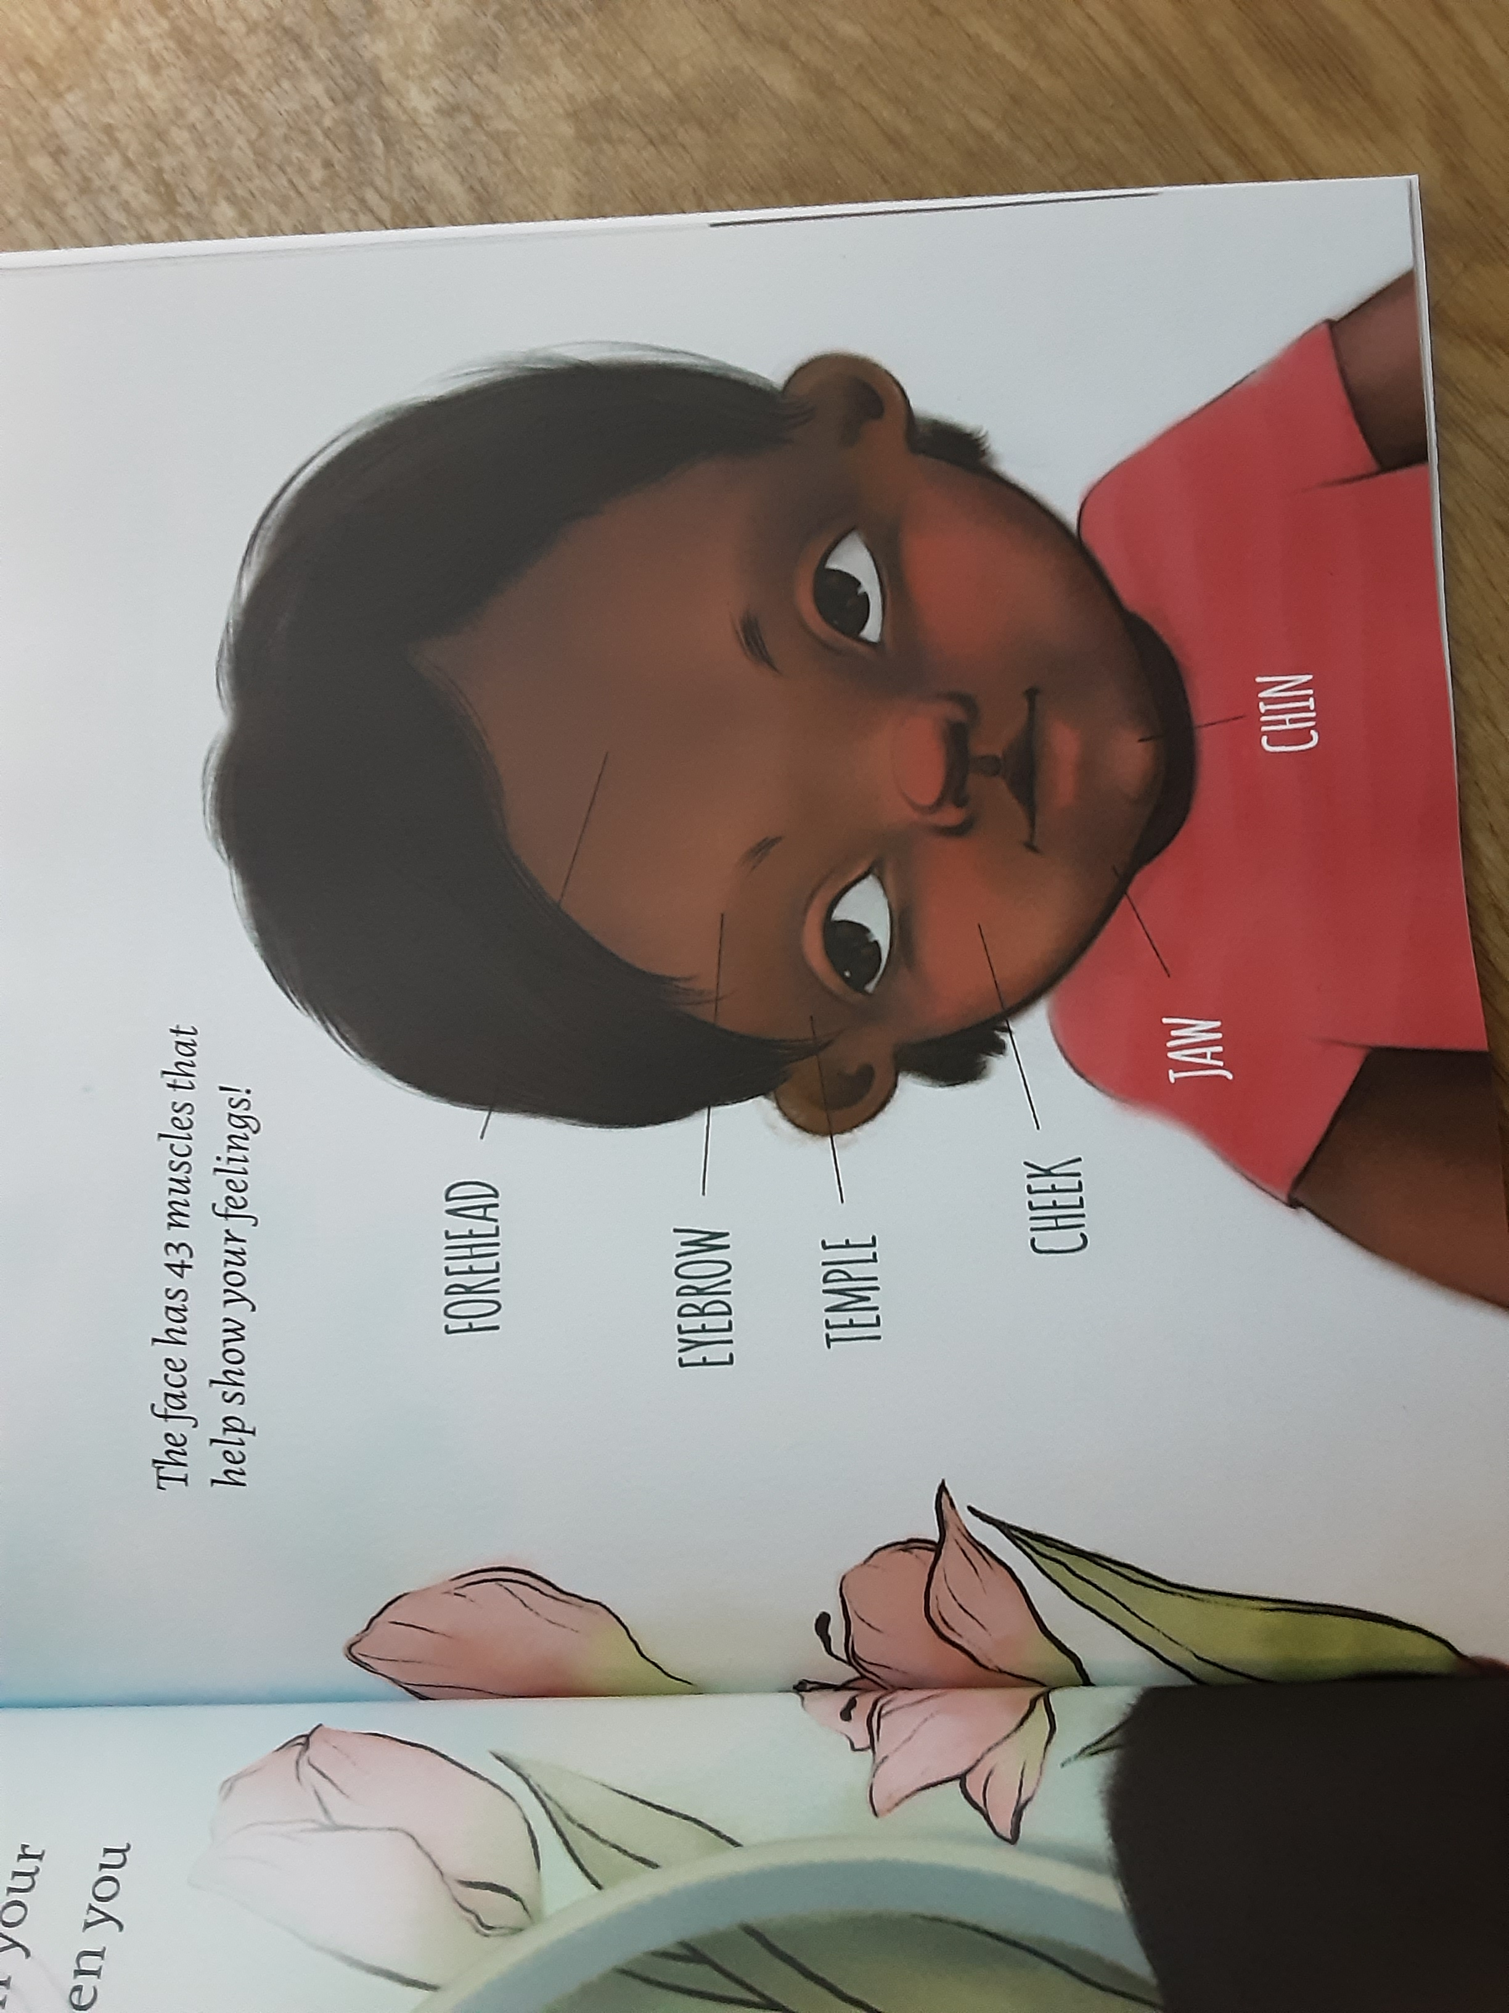
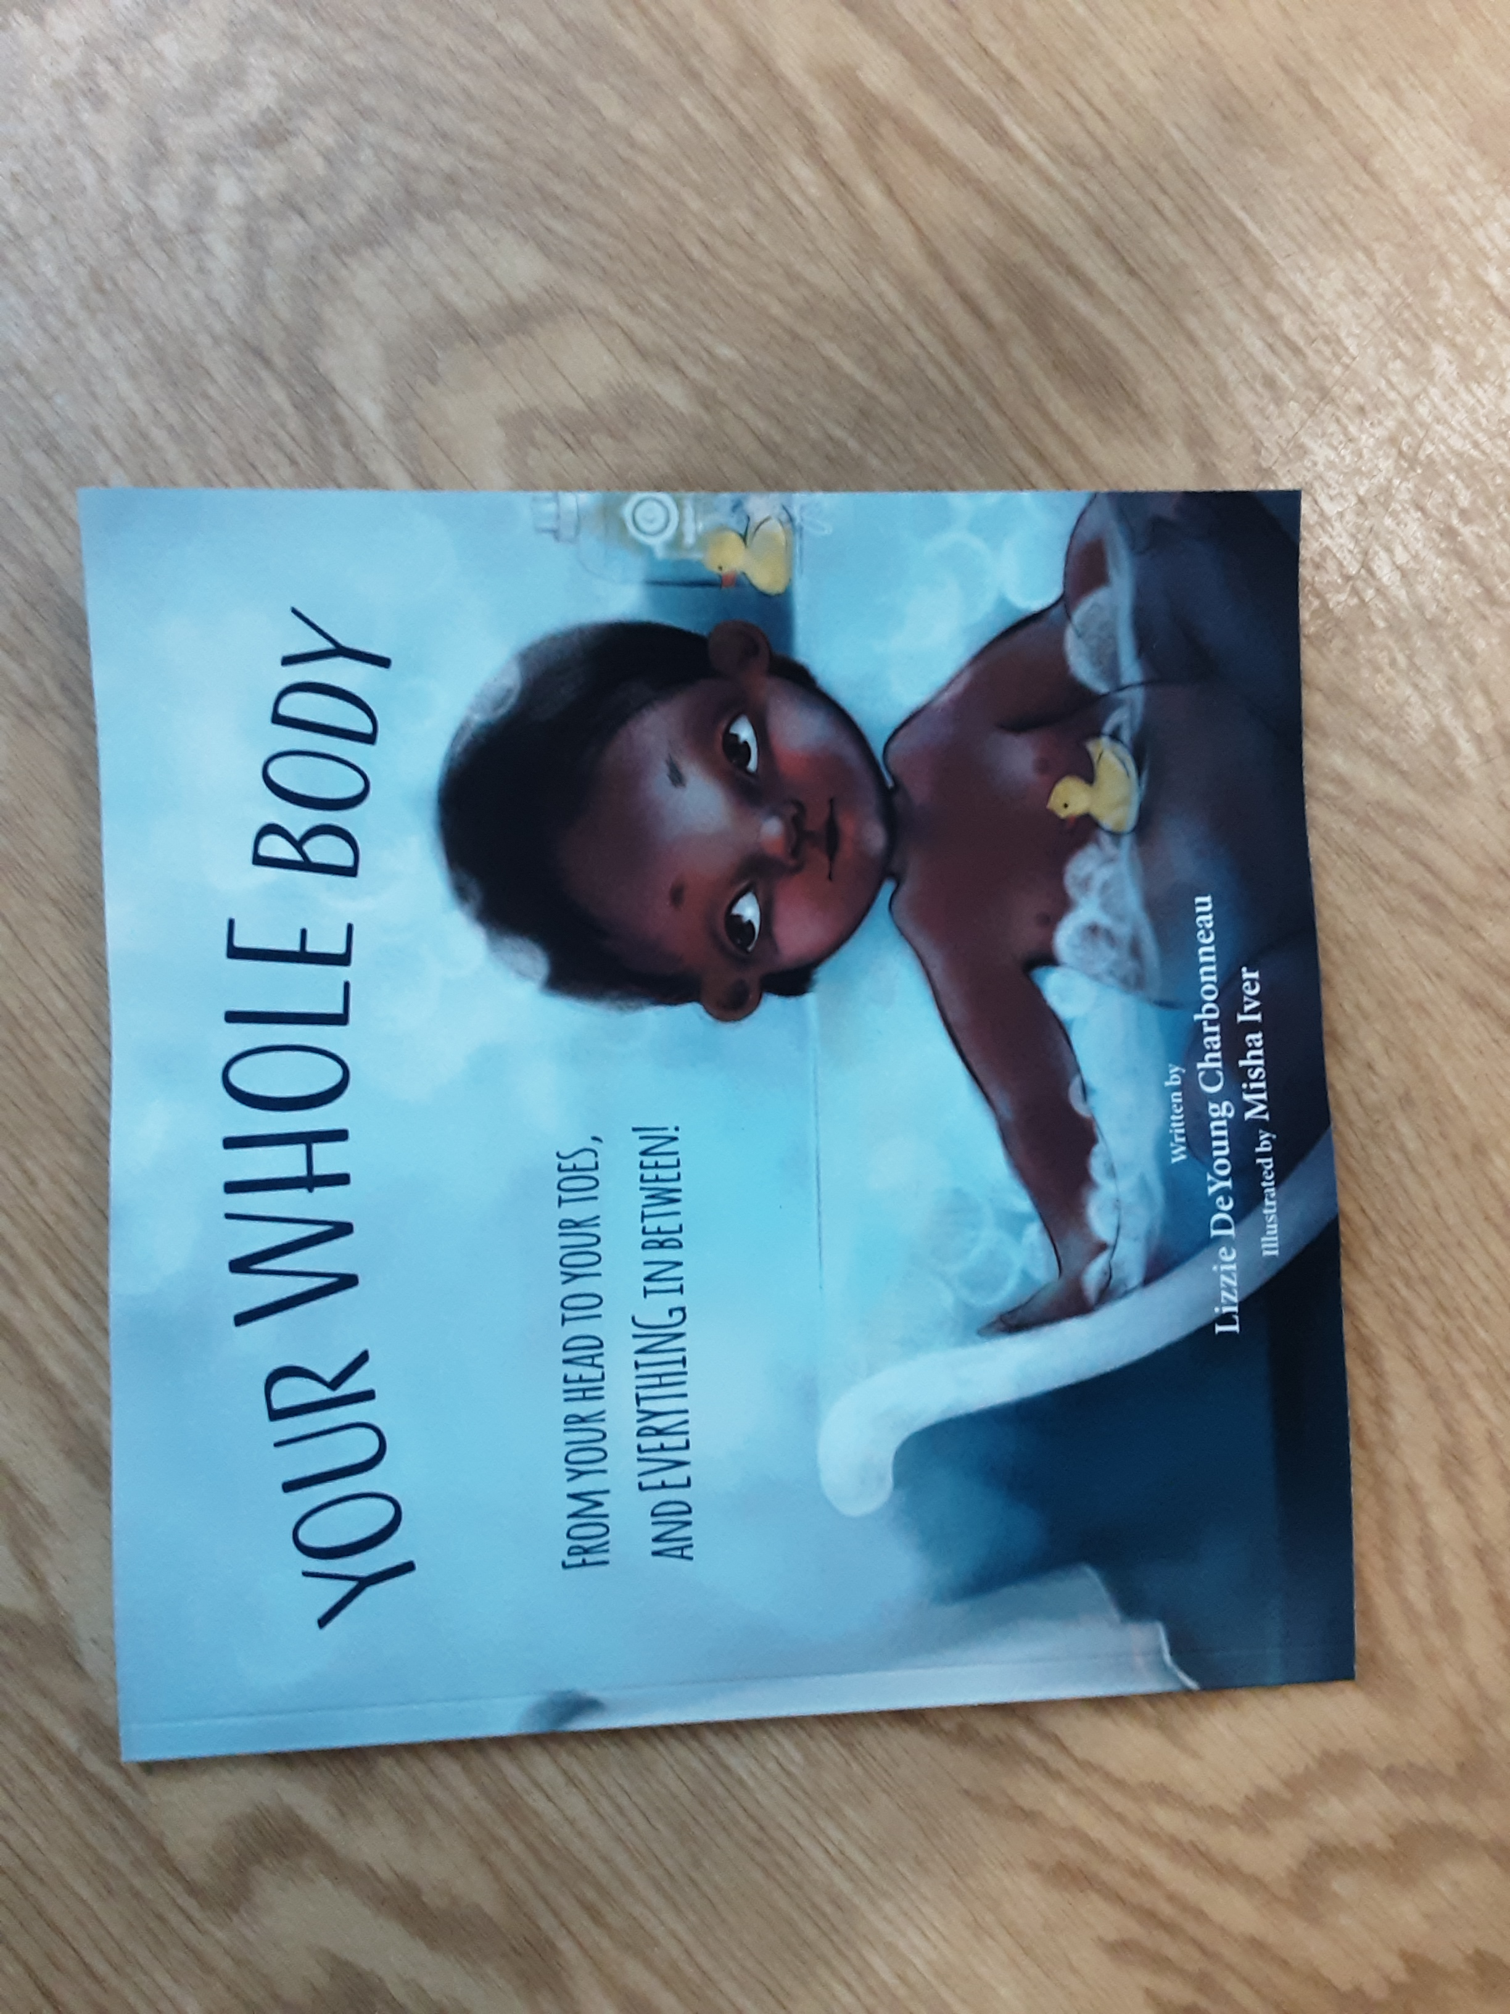
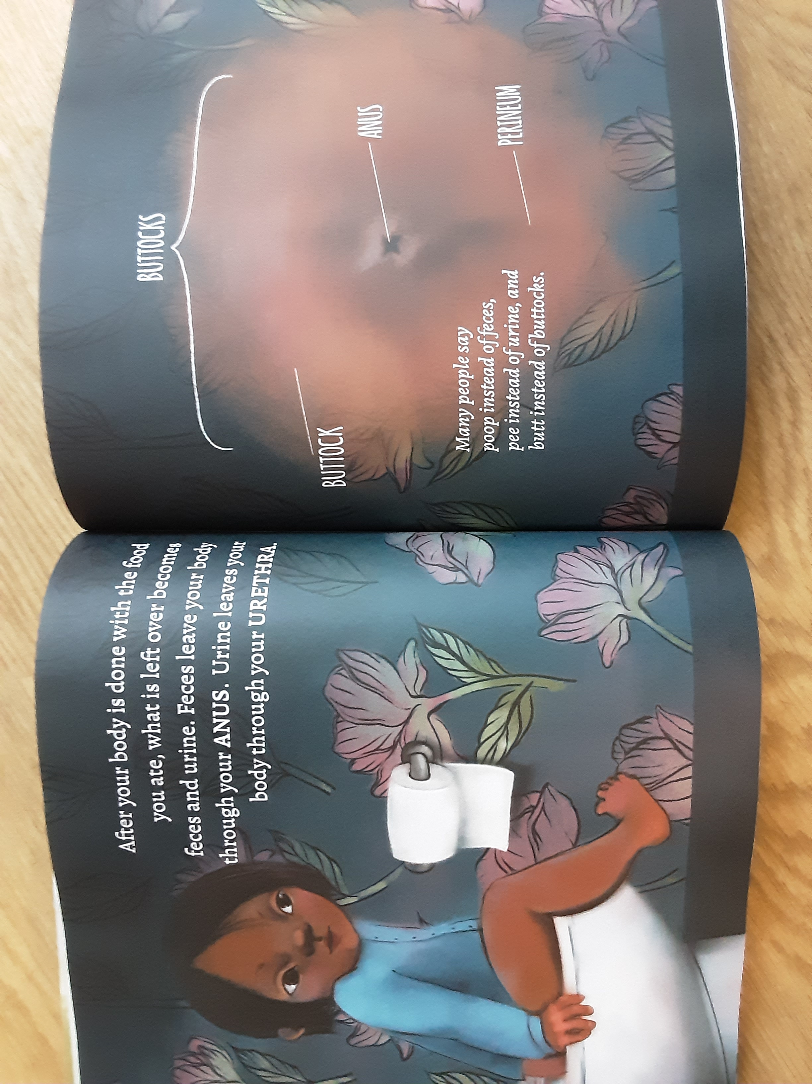
Naming your body parts

Slide 19
Science Vocabulary
KS/Year | Science Programme of study- statutory requirements | Science Programme of Study- Non statutory Notes and Guidance | Vocabulary
Year 1 | Pupils should be taught to: Identify, name, draw and label the basic parts of the human body and say which part of the body is associated with each sense. | Pupils should have plenty of opportunities to learn the names of the main body parts ( including head, neck, arms, elbows, legs, knees, face, ears, eyes, hair,mouth, teeth) through games, actions, songs and rhymes. | Head, neck, arms, elbows, legs, knees, face, ears, eyes, hair, mouth, teeth, penis, testicles, vulva
Year 2 | Pupils should be taught to: Notice that animals, including humans, have offspring which grow o Into adults. ( growing into adults’ should include reference to baby , toddler, child, teenager, adult) | They should also be introduced to the process of reproduction and growth in animals. The focus at this stage should be on helping pupils to recognise growth; they should not be expected to understand how reproduction occurs. The following examples might be used : egg, chick, chicken; egg, caterpillar, pupa, butterfly; spawn, tadpole, frog; lamb, sheep. Growing into adults can include reference to baby, toddler, child, teenager and adult. | Baby. Toddler, child, teenager, adult

Slide 20
PSHE Association - Vocabulary
KS/Year | PSHE Association Programme of Study Core Theme1 : Health and Wellbeing | PSHE Association Programme of Study Core Theme 2 : Relationships | Vocabulary
Key Stage 1 | Pupils have the opportunity to learn: 5 about change and loss and the associated feelings ( including moving home, losing toys, pets or friends, making new friends, new baby) 8 about the process of growing from young to old and how people’s needs change. 9 about growing and changing and new opportunities and responsibilities that increasing independence may bring. 10 the names for the main parts of the body ( including external genitalia) the similarities and differences between boys and girls. | Pupils have the opportunity to learn: 1 communicate their feelings to others, to recognise how others show feelings and how to respond. 9 to identify their special people ( family, friends, carers), what makes them special and how special people should care for one another. 10 to judge what kind of physical contact is acceptable, comfortable, unacceptable, and uncomfortable and how to respond ( including who to tell and how to tell them). | Boy, girl , gender, penis, testicles, vulva, pregnant, baby, child, teenager, elderly, life cycle, change, grow, feelings, love, care, comfortable feeling, uncomfortable feeling.

Slide 21
Why teach the correct names for the body parts
This matter-of-fact approach prevents body parts from seeming strange, embarrassing, bad or dirty. It also reduces bodily shame and promotes a healthy body image. As well, giving children the proper language to understand their bodies paves the way for open, judgment-free communication about sexual health
Gives language to report inappropriate behaviour: Knowing the correct words for body parts means children have the vocabulary to articulate if someone does something inappropriate. If a child knows to call their genitals a “penis” or “vulva,” they can communicate clearly if someone tries to touch them there. This allows them to tell a parent or trusted adult if abuse occurs

Slide 22

Other aspects of being safe

Slide 23

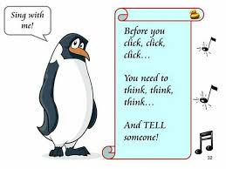
Internet safety

Slide 24
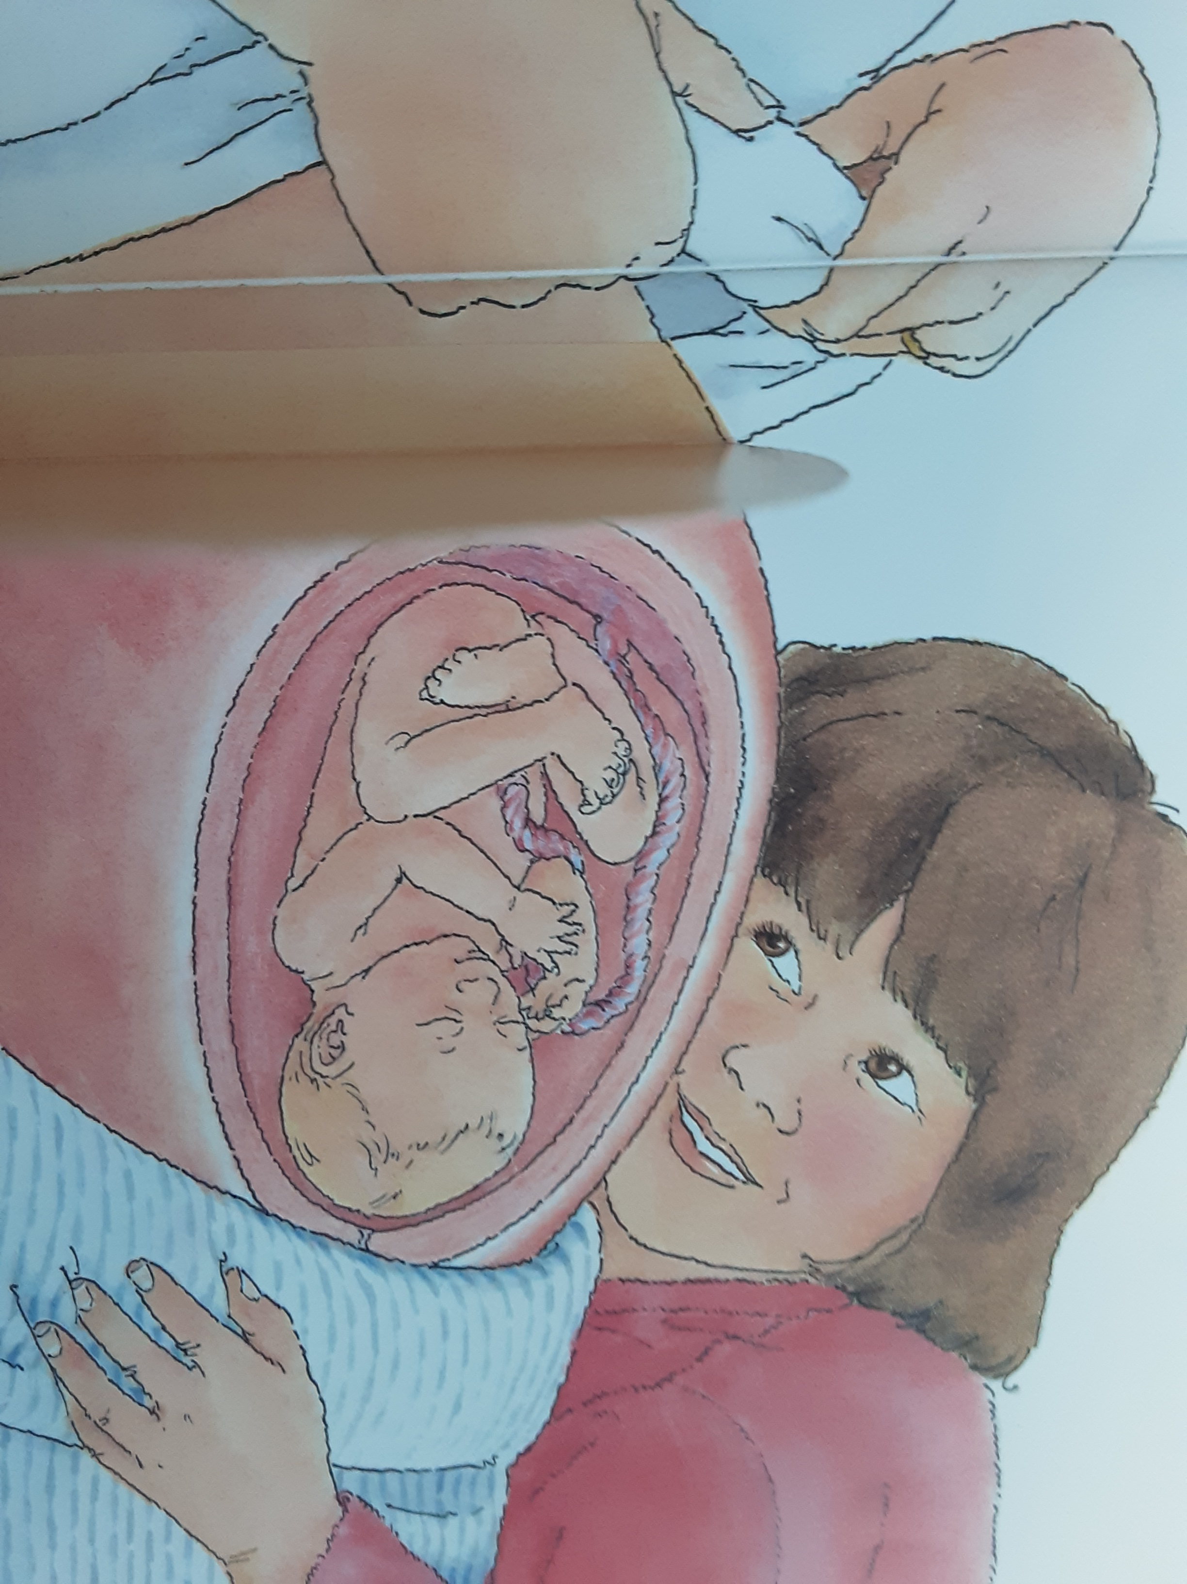
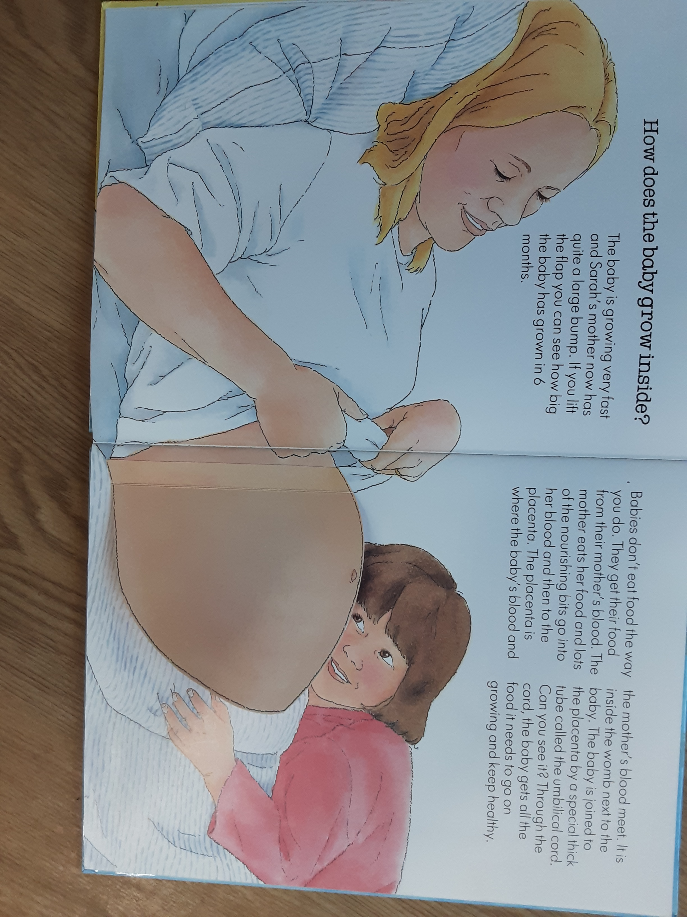
Thinking of growth and change in the summer term.

