Slide 1
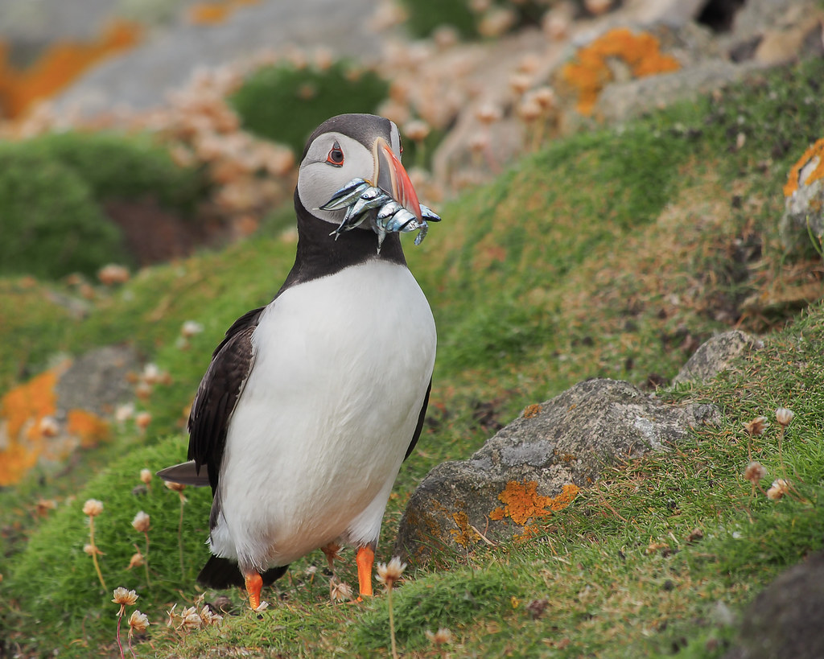
Welcome to Puffins
Mrs Eremita, Mrs Hoogstraten

Slide 2
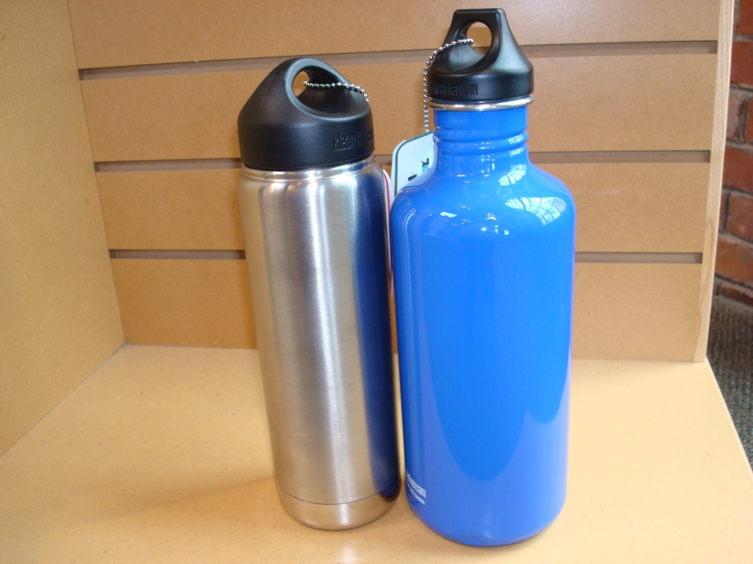
What the children need in school
Monday – Reading book, reading record, water bottle, library book
Tuesday – Reading book, reading record, water bottle
Wednesday – Come in PE kit, reading book, reading record, water bottle
Thursday – Reading book, reading record, water bottle,
Friday – Come in PE kit, reading book, reading record, water bottle, homework book

Slide 3

Website
Information about what is going on in class can be found on the Puffins’ class page on the website.
Here you can find the weekly timetable, homework and information about the curriculum each term. Additionally, there is some useful information about Little Wandle, our phonics scheme, maths resources and knowledge organisers.
Please take a look and check out the tabs at the bottom too.
https://www.sharnbrookprimary.beds.sch.uk/

Slide 4

Reading
Year 1 Reading
We believe that all our children can become fluent readers and writers. This is why we teach reading through Little Wandle Letters and Sounds Revised, which is a systematic and synthetic phonics programme.
We value reading as a crucial life skill. We want our children to read confidently for meaning and regularly enjoy reading for pleasure.
Reading for Pleasure
‘Reading for pleasure is the single most important indicator of a child’s success’ (OECD 2002).
Reading for pleasure books will go home for parents to share and read to children. Please read more about research behind the importance and impact of sharing quality children’s books with parents in the Everybody read! resources.
In Puffins, children will choose and bring home a decodable book matched to their phonic knowledge every Monday. Please enjoy reading this with your child and ensure this is returned every Monday.
On Thursdays, children choose a library book from our school library. Please return this every Thursday.
Please also visit the Little Wandle Letters and Sounds Revised parents’ resources to find information about phonics, the benefits of sharing books, how children learn to blend and other aspects of our provision, both online and through workshops.

Slide 5
Home Reading
Reading Practice
The decodable reading practice book will be taken home every Friday to ensure success can be shared with the family. Please encourage your child to share their reading and celebrate their success! Please ensure that this book is returned on Monday as we will need a full set for the next group.
We will have taught your child to read this book through reading practice sessions three times in the preceding week. These sessions are taught by a fully trained adult to small groups of approximately six children. The books are matched to the children’s secure phonic knowledge. Each reading practice session has a clear focus, so that the demands of the session do not overload the children’s working memory.

Slide 6
The reading practice sessions have been designed to focus on three key reading skills:
  decoding
  prosody: teaching children to read with understanding and expression
  comprehension: teaching children to understand the text.

Slide 7
Reading for Pleasure
‘Reading for pleasure is the single most important indicator of a child’s success’ (OECD 2002).
Reading for pleasure books will go home for parents to share and read to children. Please read more about research behind the importance and impact of sharing quality children’s books with parents in the Everybody read! resources.
In Puffins, children will choose and bring home a decodable book matched to their phonic knowledge every Monday. Please enjoy reading this with your child and ensure this is returned every Monday.
On Mondays, children also choose a library book from our school library. Please return this every Monday.
Please also visit the Little Wandle Letters and Sounds Revised parents’ resources to find information about phonics, the benefits of sharing books, how children learn to blend and other aspects of our provision, both online and through workshops.

Slide 8
Spelling
Some spellings linked to the sounds we are focusing on each week, and additionally some tricky words will be posted on our class page every Friday for your child to practice at home.

Slide 9

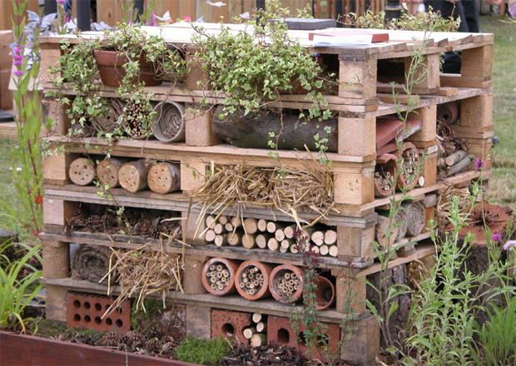
Other Homework
Please record work in the homework book provided. Please do not feel you need to print anything out. Children can draw or make homework. We want them to enjoy it.
We will check the homework books on Fridays, or email me a picture of something that they have made .

Slide 10
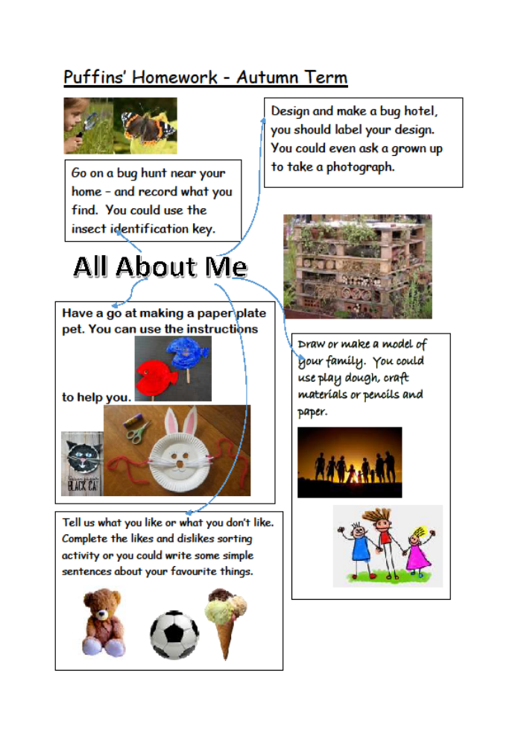

Slide 11
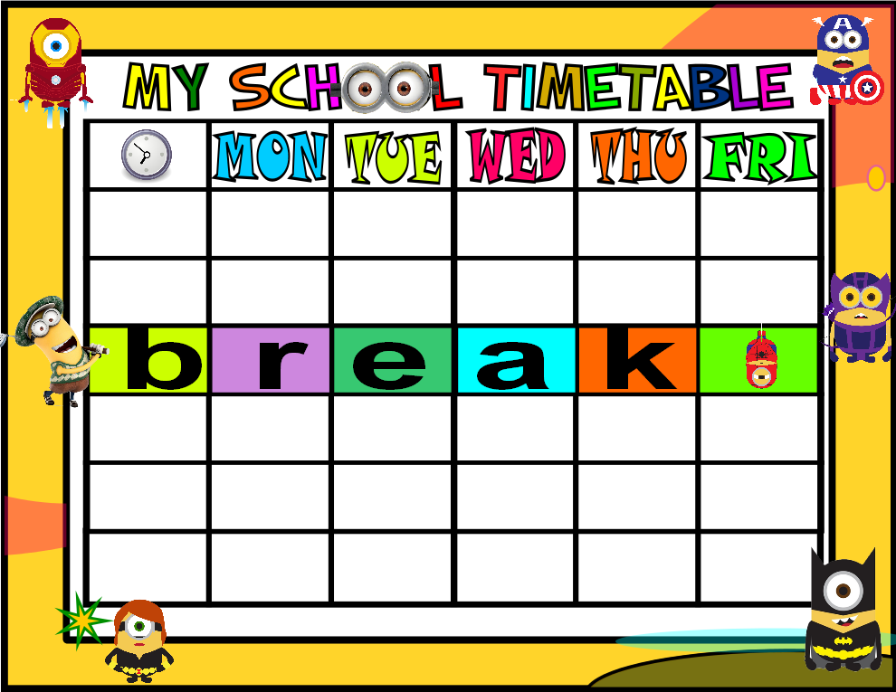
Timetable
Please check the website for a new timetable every week – this will be posted on Sunday evenings.

Slide 12
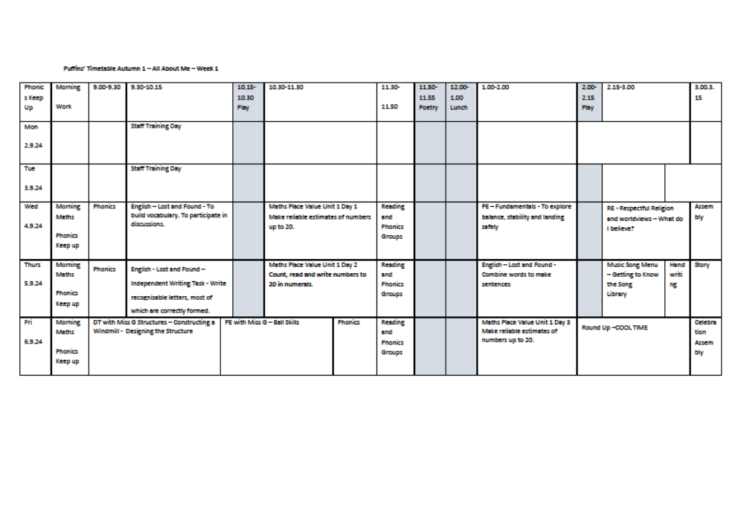

Slide 13
Lift off to Language
Lift off to Language is a program created by the Speech and Language Therapy Service. It is a great aid in teaching listening skills, speaking, turn-taking and self regulation.
Every year one child will have a chance to participate and sessions will be run by Mrs Hoogstraten. Each course lasts 6 weeks and will be run every half term.

Slide 14
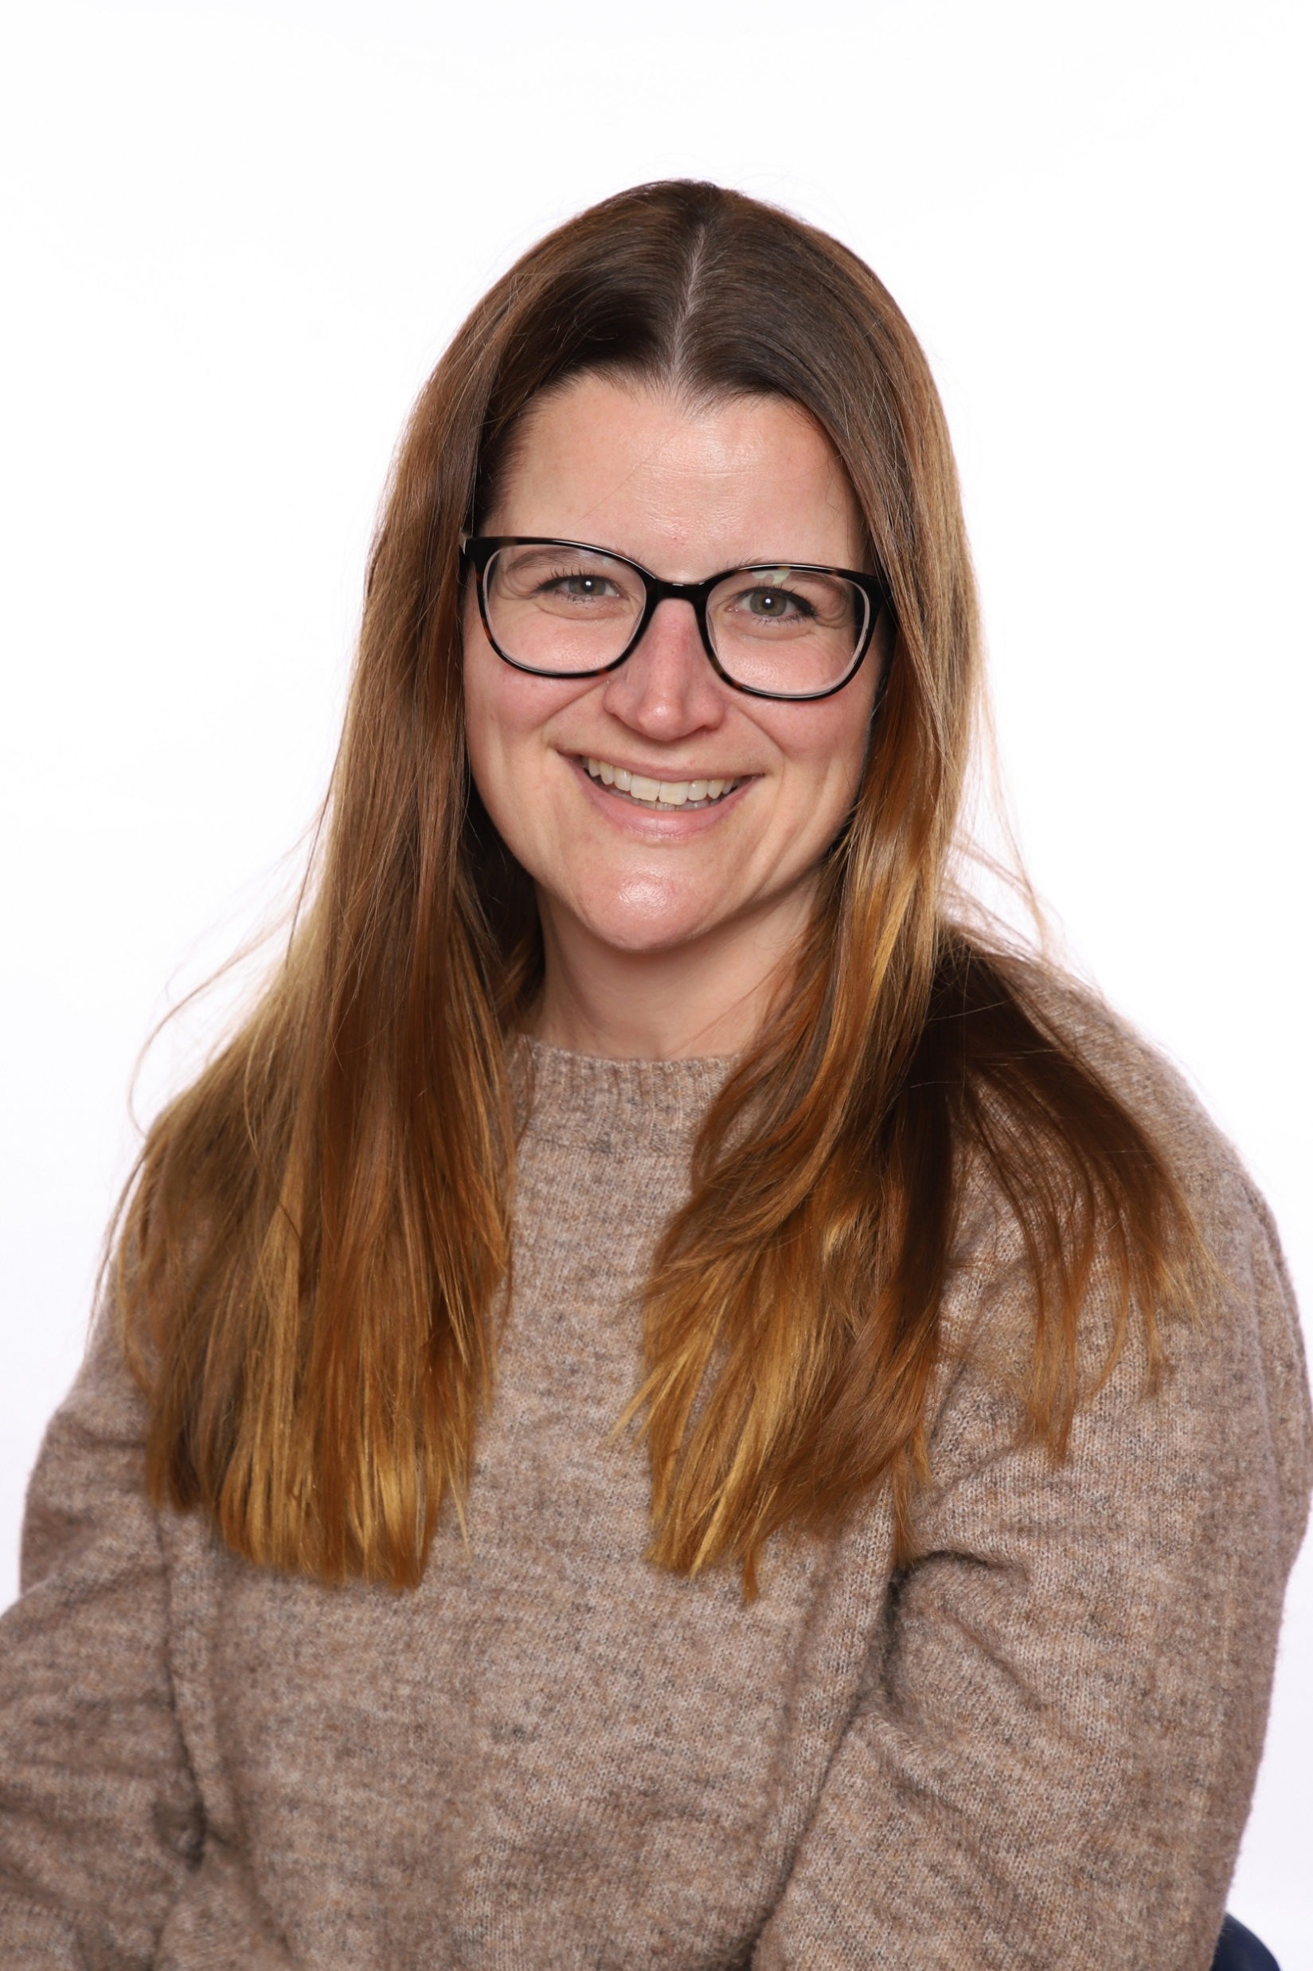
Suzy Oakley – Mental Health Lead
Apologies I can’t be here in person to meet you all
At Sharnbrook Primary, I work with children and families to ensure children have access to the support they need. This might be support in school or it could be from outside agencies if required
If you have anything you would like to talk to me about, I am available on the playground most mornings or you can contact me by email soakley@sharnbrookprimary.beds.sch.uk (it is also on all of the class pages on the website)

Slide 15
and finally…
If you have any further questions you can catch me at the end of the school day or you can email me on
meremita@sharnbrookprimary.beds.sch.uk
Please remember our priority is to be with your children.
My release time is on a Friday so I will endeavor to reply to emails on Fridays.

Slide 16
Thank you for listening.

