Slide 2

WELCOME TO YEAR 5 SWANS CLASS
Information presentation for parents and carers.
Teaching team are:
Mrs Leach
Mrs Adair
Mrs Chance

Slide 3
WEEKLY TIMETABLE AND EXPECTATIONS
Daily:
Bring reading book
Bring reading record
Ensure equipment is packed
Clean water bottle
Tue & Fri (PE Days)
Wear full PE kit to school
🔑
Key point
Please make sure reading records and books come into school every single day.
Children can write in their own reading record books.

Slide 4
Timetable
Weekly timetable will be on the school website.
Lessons commence at 8.45.
Interventions will take place from 8.45.

Slide 5
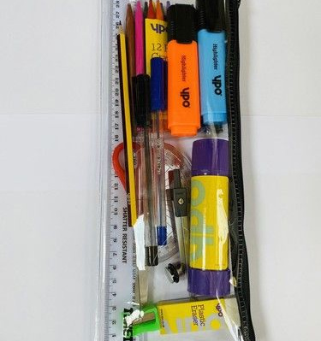
ESSENTIAL CLASSROOM EQUIPMENT
Children should bring a pencil case containing essential stationery every day:
Blue ballpoint pen (Biro)
Standard HB pencil and rubber
Ruler, glue stick, and scissors
Colouring pencils
Protractors and compasses for the summer term.
🔍

Slide 6

HOMEWORK
Reading Every Day
Children should read for 20–30 minutes daily at home to build strong vocabulary and comprehension skills.
Please listen to your child read aloud to an adult at least once a week to aid fluency, tone, and expression.

Slide 7



Spelling Shed and TTR homework are both due to be completed by Monday.
Spelling Shed
Practise spelling patterns for a minimum of 5 minutes daily to boost confidence.
Spellings are tested on a Monday.
TTRS (Times Tables)
Complete at least 25 minutes per week on Times Tables Rock Stars to maintain rapid recall.
We will move beyond 12x tables in year 5.
Mirodo Website
We will make regular use of Mirodo for tasks. Please explore this digital tool with your child.

Slide 8
ADDITIONAL TASKS AND LIFE SKILLS
Flexible Learning Tasks
Other homework, such as topic research or finishing classroom activities, will be set whenever required throughout the term.
Key Life Skill: Please ensure your son or daughter can confidently tell the time using analogue and digital clocks in both 12 and 24 hour.

Slide 9
ENRICHMENT VISITS AND TRIPS

Slide 10

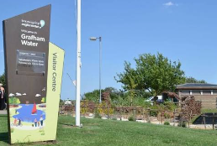
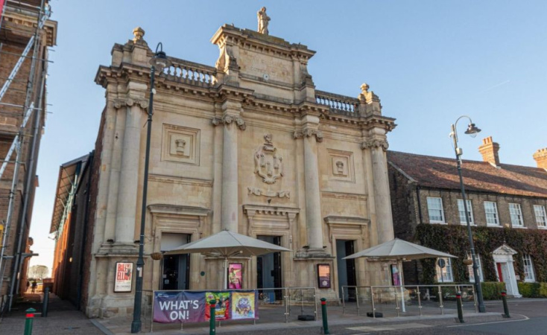
AUTUMN AND SPRING TERM EVENTS
Autumn Term: Astronomical Society
An exciting after-school astronomy workshop held directly in school during the Autumn Term.
Spring Term: Orchestra Unwrapped
A inspiring musical visit to experience live orchestral music at Bedford Corn Exchange.
Grafham Water Residential
07.10.2026-09.10.2026

Slide 11
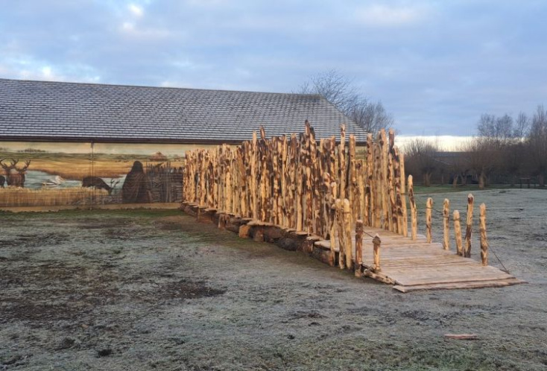
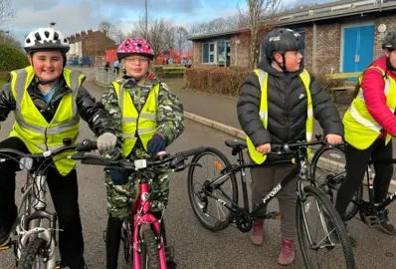
SUMMER TERM VISITS AND PRACTICAL SKILLS
Summer Term: Flag Fen
A historical day trip exploring ancient Bronze Age heritage in Peterborough.
Bikeability Training Level 2
Practical cycle safety course held in school from 14.06.27 – 17.06.2027

Slide 12
INDEPENDENT TRAVEL TO SCHOOL
Walking To and From School
In Year 5, some parents choose to allow their child to walk independently to
or from school as they grow in maturity.
Please ensure you let me know by email or written letter if you would like your son/daughter to walk to/from school independently.
Children will be released from the classroom at the end of the school day.

Slide 13
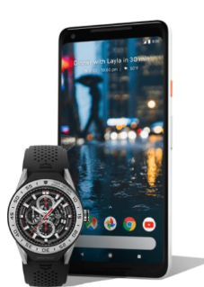
MOBILE PHONE POLICY
Phones and smart watches in School
If your child carries a mobile phone/smartch watch for their journey when walking independently, it must be brought with clear guidelines.
All mobile phones and smart watches will be handed to the class teacher upon arrival and will be stored safely until the end of the day.
No mobile phones or smart watches are to go on educational trips.

Slide 14
SCHOOL WEBSITE AND CLASS PAGE
Please check the Swans class page on our school website regularly for weekly updates, timetables, and key learning documents.
Maths: links to weekly lessons will be on the class page of the website.

Slide 15
CLASSROOM RESOURCES ONLINE
Helpful Downloads Available
Knowledge Organisers for subjects
Vocabulary for maths
Reading Support Questions to ask your child at home
Using knowledge organisers at home helps reinforce key terms and topic facts!

Slide 16

SCHOOL NEWSLETTERS AND KEY DATES
Stay Up-to-Date
Our school newsletters contain vital information, event reminders, and term dates.
🧠
Remember
Please read newsletters regularly to stay updated and share exciting school news with your child!

Slide 17

HOME-SCHOOL COMMUNICATION
We are always happy to discuss any questions or concerns regarding your child's progress or wellbeing.
Contact email:
sleach@sharnbrookprimary.beds.sch.uk
Emails sent outside school hours may not be seen immediately.
Contact Reception for urgent matters during the day, as emails sent to myself will probably not be seen until the end of the day.

Slide 18
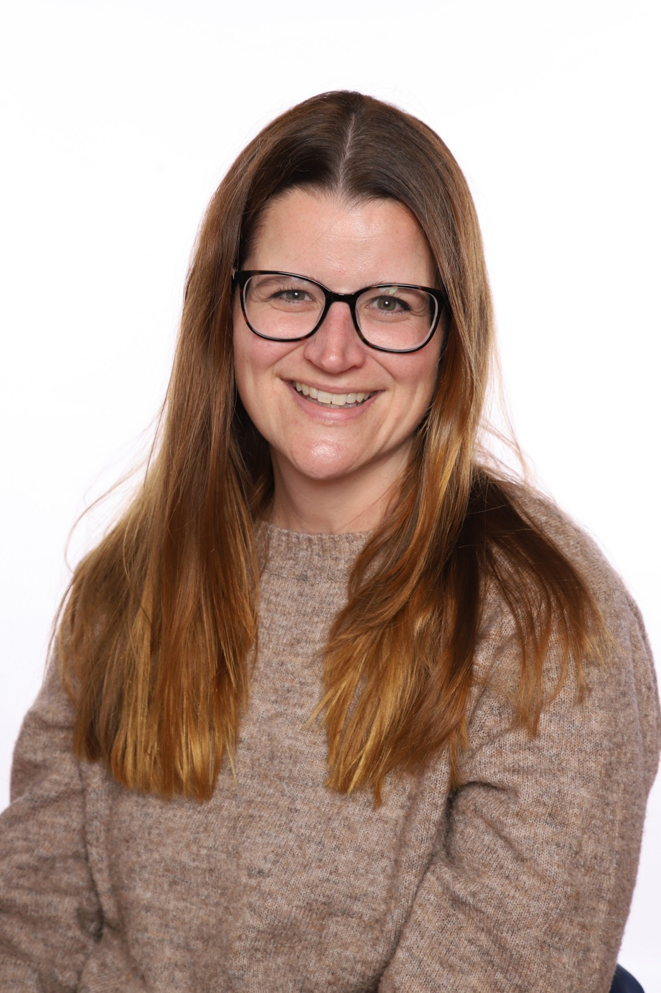
Suzy Oakley – Mental Health Lead
Apologies I can’t be here in person to meet you all
At Sharnbrook Primary, I work with children and families to ensure children have access to the support they need. This might be support in school or it could be from outside agencies if required
If you have anything you would like to talk to me about, I am available on the playground most mornings or you can contact me by email soakley@sharnbrookprimary.beds.sch.uk (it is also on all of the class pages on the website)

Slide 19
Thank you for coming!
Do you have any questions?

