Slide 1
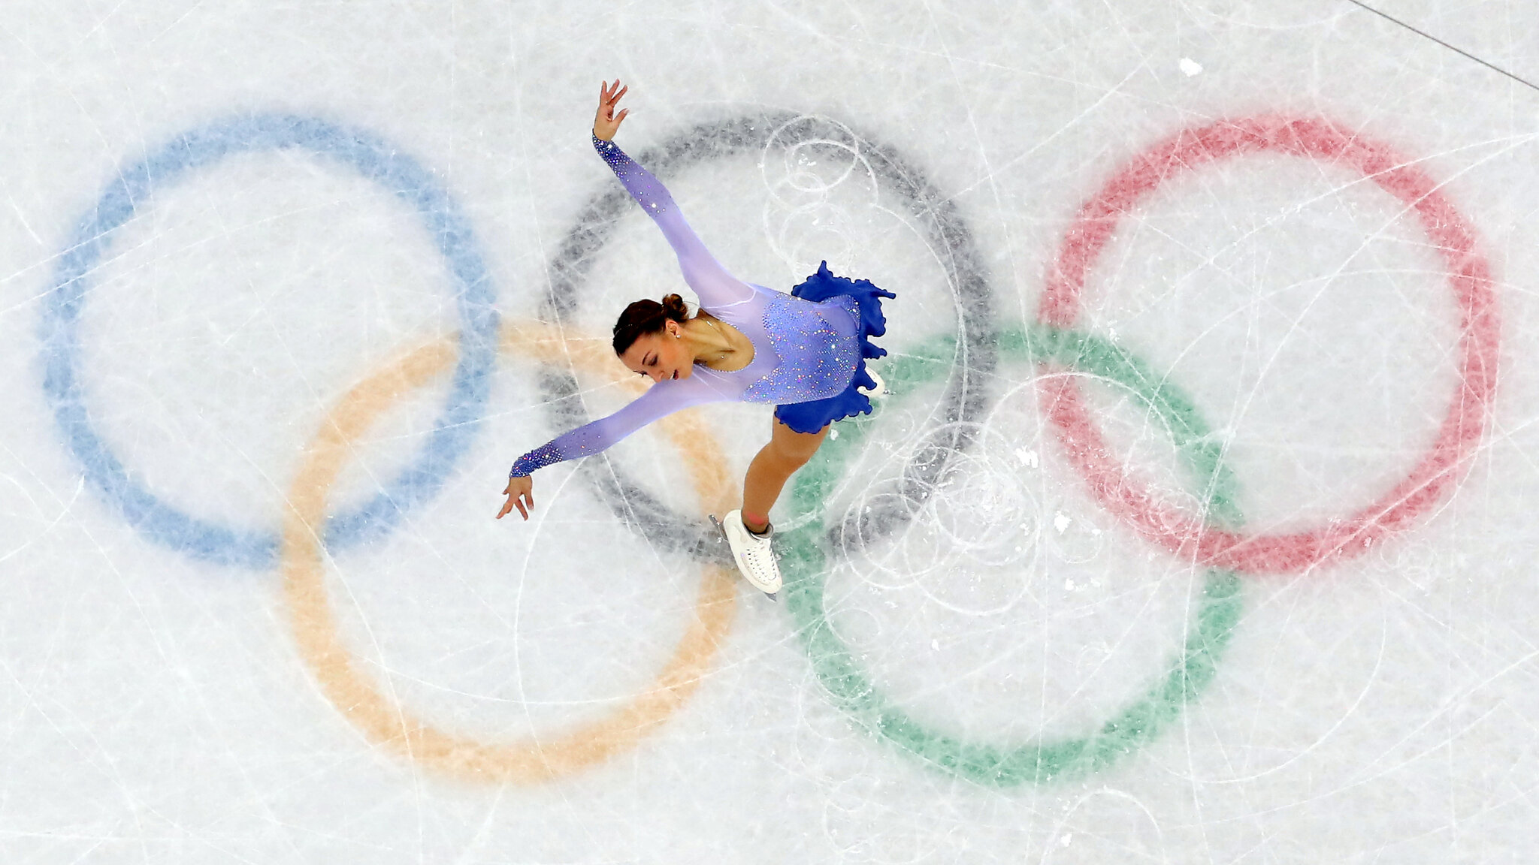



Winter Olympic Thursday 12th February 26
Slalom Beef Lasagne served with Garlic Bread
Or
5 Bean Vegetable Chilli with Rice
*****
Speed Skating Green Bean
Sledding Carrots
*****
Iced Sponge

