Slide 1







World Book Day
5th March 2026
Lady and the tramp Chicken spaghetti meatballs
BFG’s Human Bean Fajita with Rice
Peter Rabbit’s Carrots
Gangster Granny's Cabbage
Charlie and The Chocolate Factory Cake with Oompa Loompa Chocolate Sauce
BORCELLE

Slide 2
World Book Day
Lady and the tramp Chicken spaghetti meatballs C104, V225, SD8
BFG’s Human Bean Fajita V308 with Rice SD84
Peter Rabbit’s Carrots SD28
Gangster Granny's Cabbage SD23
Charlie and The Chocolate Factory Cake D198 with Oompa Loompa Chocolate Sauce D3
BORCELLE

Slide 3

World Book Day
Competition
Draw your version of a Charlie and the Chocolate Factory Cake!
Send a picture to the Caterlink team and winners will receive a golden ticket to a book voucher.
BORCELLE

Slide 4
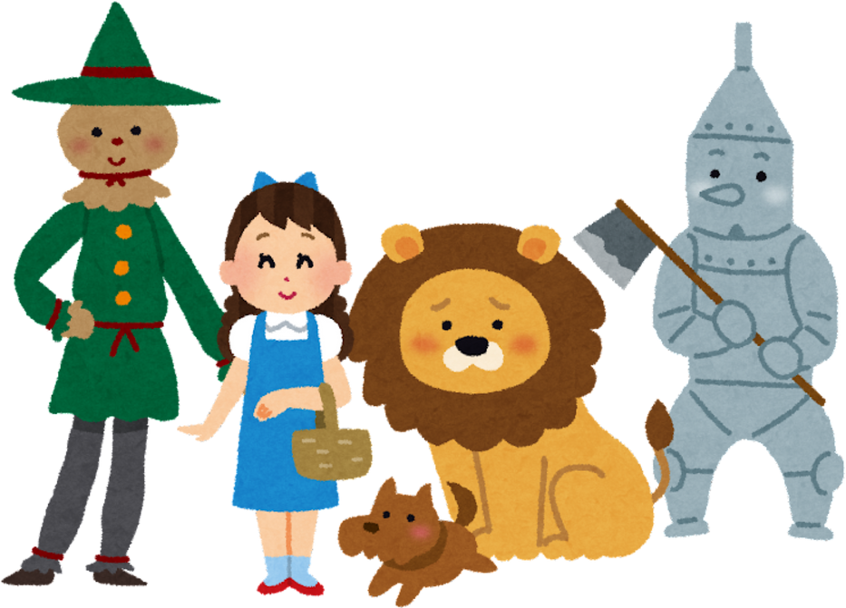
World Book Day
Kitchen Competition
Kitchen teams...best dressed competition
Send a picture to your area manager and winners will receive a amazon voucher from Sue Janes.
BORCELLE

