Slide 2
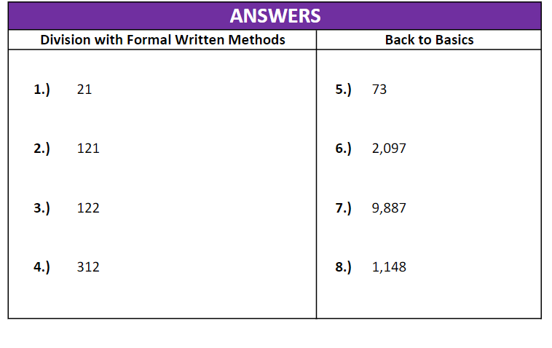

Slide 3
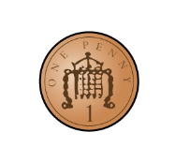
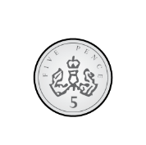
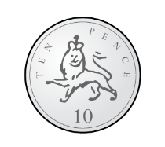
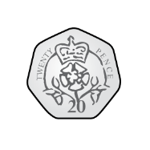
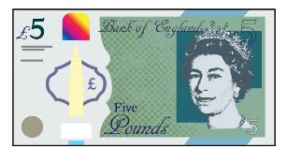
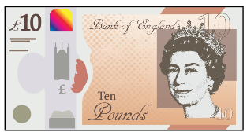
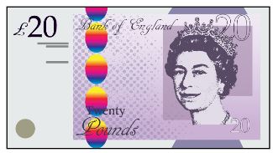
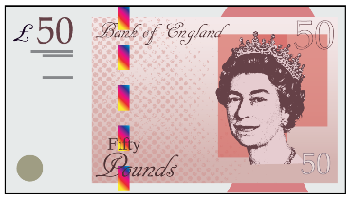
Some children are converting 1206 p into pounds.
Who is correct?
Whitney
Rosie
Teddy
What have the others done wrong?
Explain your answer.
1206 p $=$ £12.6
1206 p $=$ £12.06
1206 p $=$ £120.6

Slide 4
Addition and Subtraction
Subtraction: written methods and choosing strategies
Objectives
Day 1
Count up to solve 3-digit subtractions.
Day 2
Subtract 3-digit numbers using expanded column subtraction.
Day 3
Subtract 3-digit numbers choosing an efficient method.
Day 4
Investigate patterns when subtracting 3-digit numbers.
Notes:
Before teaching, be aware that:
On Day 1, 2 & 4 children will need mini-whiteboards and pens.

Slide 5
Addition and Subtraction
Subtraction: written methods and choosing strategies
Starters
Day 1
Subtract multiples of 10 (pre-requisite skills)
Day 2
Say what calculation is necessary to solve word problems (pre-requisite skills)
Day 3
Complements to next 100 (pre-requisite skills)
Day 4
Round 3-digit numbers to the nearest 10 or 100 (simmering skills)
Notes:
Choose starters that suit your class by dragging and dropping the relevant slide or slides below to the start of the teaching for each day.

Slide 7
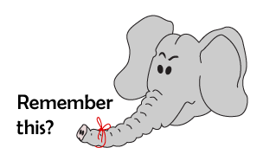
Addition and Subtraction
Subtraction: written methods and choosing strategies
Starter
Round 3-digit numbers to the nearest 10 or 100
Notes:
Simmering skills – to use this starter, drag this slide to the start of Day 4
Call out some 3-digit numbers. Children work in pairs, one to round the number to the nearest 10 and the other to the nearest 100. When did they round to the same number? (e.g. 397)

Slide 8
Addition and Subtraction
Subtraction: written methods and choosing strategies
Objectives
Day 1
Count up to solve 3-digit subtractions.

Slide 9
Day 1: Count up to solve 3-digit subtractions.
Some cyclists are cycling from John O’Groats in northern Scotland to Land’s End in Cornwall, over 10 days. It’s 874 miles!
So far, they have cycled 625 miles.
How far have they still got to cycle?
Let’s draw a bar model to show the problem…
Total distance - 874 miles
How far gone - 625 miles
Miles Left?
How can we find the difference between 874 and 625?

Slide 10
Day 1: Count up to solve 3-digit subtractions.
We can use Frog!
Draw a number line and mark on 625 and 874…
Add 100, 75 and 74 to find how many miles left.
Frog jumps 75 to 700…
… and then 100 to 800...
… then 74 to 874.
75
100
74
625
700
800
874

Slide 11
Day 1: Count up to solve 3-digit subtractions.
Work in pairs to find the answers to 524 - 378 and 705 - 567 using Frog.
Let’s check
524 – 378.
100 + 24 + 22 = ?
524 - 378 = ?
How far to the next 100?
How far to 500?
How far to 524?
22
100
24
378
400
500
524

Slide 12
Day 1: Count up to solve 3-digit subtractions.
Let’s check 705 - 567…
100 + 33 + 5 = ?
705 - 567 = ?
How far to the next 100?
How far to 700?
How far to 705?
33
100
5
567
600
700
705
Notes:
Today would be a great day to use a problem-solving investigation – Wonderful 1089 – as the group activity, which you can find in this unit’s IN-DEPTH INVESTIGATION box on Hamilton’s website.
Alternatively, children can now go on to do differentiated GROUP ACTIVITIES. You can find Hamilton’s group activities in this unit’s TEACHING AND GROUP ACTIVITIES download.
WT: Use counting up to find the difference between two 3-digit numbers, with support.
ARE: Use counting up to find the difference between two 3-digit numbers.
GD: Use counting up to find the difference between two 3-digit numbers, using only 2 jumps.

Slide 13
Investigation: Adult Sheet
Notes:
Today would be a great day to use this problem-solving investigation – Wonderful 1089 – as the group activity, which you can find in this unit’s IN-DEPTH INVESTIGATION box on Hamilton’s website.

Slide 14
Investigation: Child Sheet
Notes:
Today would be a great day to use this problem-solving investigation – Wonderful 1089 – as the group activity, which you can find in this unit’s IN-DEPTH INVESTIGATION box on Hamilton’s website.

Slide 15
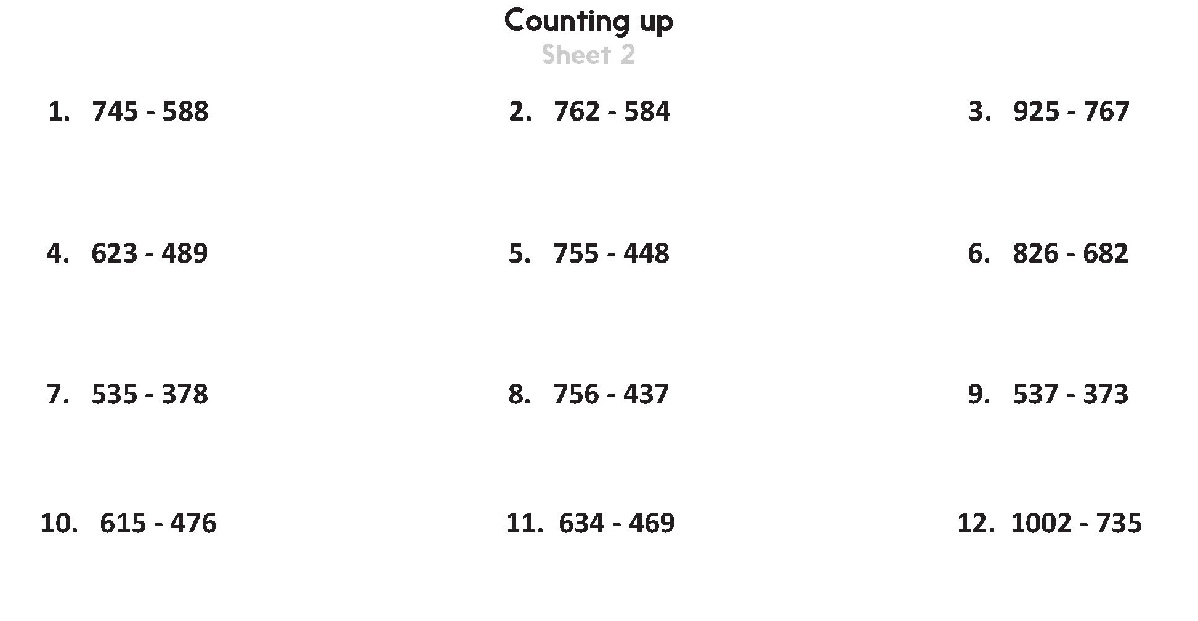
Challenge
Notes:
The Practice Sheet on this slide is suitable for most children.
Differentiated PRACTICE WORKSHEETS are available on Hamilton’s website in this unit’s PROCEDURAL FLUENCY box.
WT: Counting up Sheet 1.
ARE: Counting up Sheet 2, sketch ENL to solve.
GD: Counting up Sheet 2 – try to solve with 2 jumps.

Slide 17
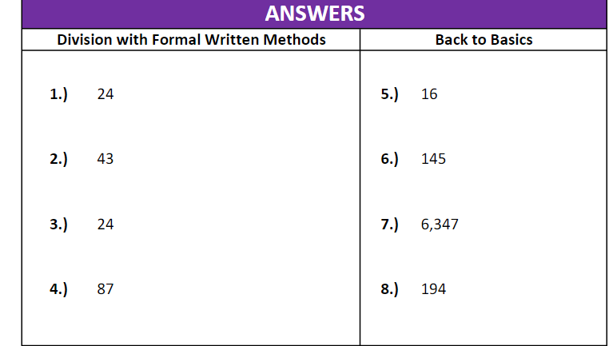

Slide 18
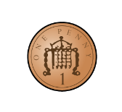
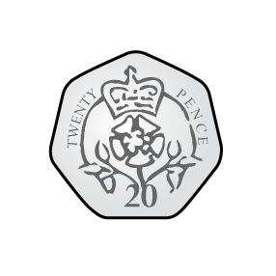
Eva has these coins:
She picks three coins at a time.
Decide whether the statements will be always, sometimes or never true.
She can make a total which ends in 2
She can make an odd amount.
She can make an amount greater than £6
She can make a total which is a multiple of 5 pence
Can you think of your own always, sometimes, never statements?

Slide 19
Addition and Subtraction
Subtraction: written methods and choosing strategies
Objectives
Day 2
Subtract 3-digit numbers using expanded column subtraction.

Slide 20
Day 2: Subtract 3-digit numbers using expanded column subtraction.
Let’s try 725 - 462 using decomposition.
700 20 5
- 400 60 2
600 120
First partition the numbers and set them out neatly.
200
60
3
725 - 462 = 263
Subtract the 1s.
5 - 2 = ?
Finally recombine 200, 60 and 3.
60 is bigger than 20 so take 100 from the 700 and add it to the 10s.
Subtract the 100s. 600 - 400 = ?
Now subtract the 10s. 120 - 60 = ?

Slide 21
Day 2: Subtract 3-digit numbers using expanded column subtraction.
Now let’s try 417 - 254. How many exchanges across columns will we need?
400 10 7
- 200 50 4
300 110
100
60
3
Partition the numbers and set them out neatly.
417 - 254 = 163
Subtract the 1s.
7 - 4 = ?
Finally recombine 100, 60 and 3.
50 is bigger than 10 so take 100 from the 400 and add it to the 10s.
Subtract the 100s. 300 - 200 = ?
Now subtract the 10s. 110 - 50 = ?

Slide 22
Day 2: Subtract 3-digit numbers using expanded column subtraction.
600 20 4
- 300 80 1
500 120
Now let’s try 624 - 381.
How many exchanges across columns will we need?
200
40
3
Who can talk us through this one?
624 - 381 = 243
This process is called decomposition because we decompose (take apart) the 600 into 500 and 100, so we can use the 100 in the 10s column.

Slide 23
600 1
Day 2: Subtract 3-digit numbers using expanded column subtraction.
Now let’s try 745 - 367.
How many exchanges across columns will we need this time?
700 40 5
- 300 60 7
30 15
Let’s check through.
300
70
8
745 - 367 = 378
7 is bigger than 5 so take 10 from the 40 and add it to the 1s.
Finally recombine 300, 70 and 8.
15 - 7 = ?
60 is bigger than 30 so take 100 from the 700 and add it to the 10s.
Subtract the 100s. 600 - 300 = ?
.
130 - 60 = ?

Slide 24
600 1
Day 2: Subtract 3-digit numbers using expanded column subtraction.
Now try 742 - 357
on your whiteboards.
700 40 2
- 300 50 7
30 12
300
80
5
Who can talk us through this one?
742 - 357 = 385
That one needed
two exchanges between columns!
Notes:
Children can now go on to do differentiated GROUP ACTIVITIES. You can find Hamilton’s group activities in this unit’s TEACHING AND GROUP ACTIVITIES download.
WT: Use expanded column subtraction to subtract 3-digit numbers with decomposition; use ‘counting up’ if struggling.
ARE: Use expanded column subtraction to subtract 3-digit numbers with decomposition, model with base 10 equipment.
GD: Use expanded column subtraction to subtract 3-digit numbers with decomposition, use addition to check answers.

Slide 25
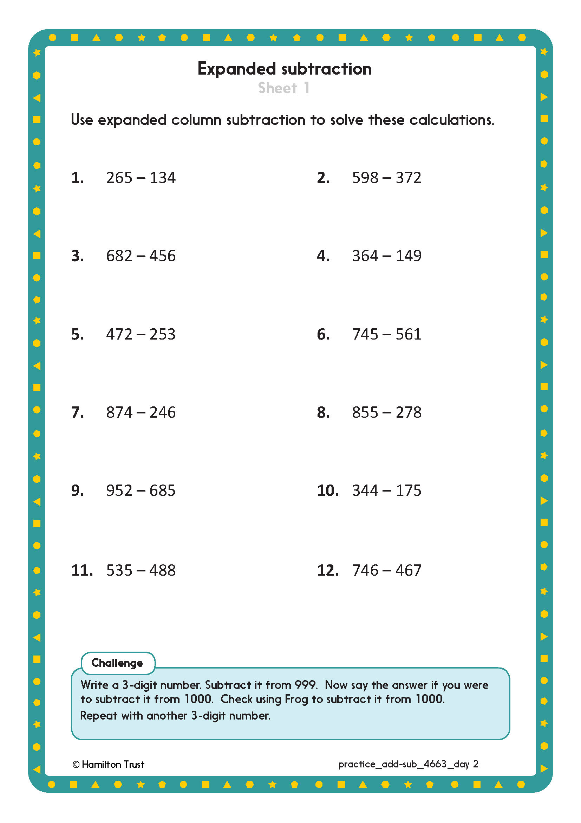
Challenge
Notes:
The Practice Sheet on this slide is suitable for most children.
Differentiated PRACTICE WORKSHEETS are available on Hamilton’s website in this unit’s PROCEDURAL FLUENCY box.
WT: Expanded subtraction Sheet 1, use base 10 equipment to model.
ARE: Expanded subtraction Sheet 1, start at q.5.
GD: Expanded subtraction Sheet 1, start at q.5 and first write the subtractions in order predicting which will give the smallest or greatest answers.

Slide 26
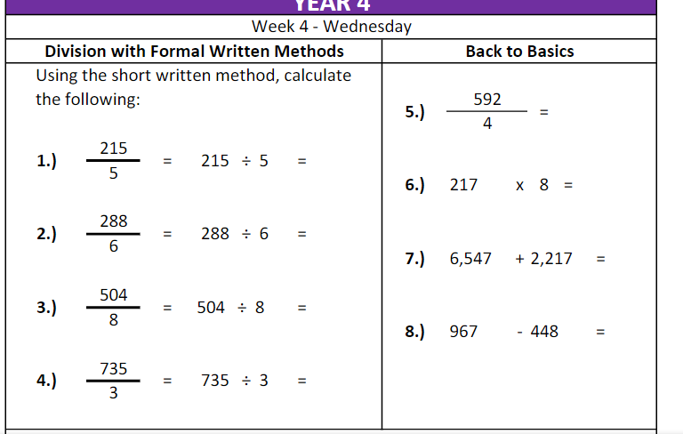

Slide 28
Teddy, Dora and Jack are buying toys.
Teddy
Dora
Jack
How much money could Jack have?
Is there only one answer?
I have £5.43
I have 534p
I have more money than Dora but less than Teddy.

Slide 29
Addition and Subtraction
Subtraction: written methods and choosing strategies
Objectives
Day 3
Subtract 3-digit numbers choosing an efficient method.

Slide 30
300
Day 3: Subtract 3-digit numbers choosing an efficient method.
Let’s try
403 – 267 using decomposition.
400 0 3
- 200 60 7
90 13
First partition the numbers and set them out neatly.
100
30
6
403 - 267 = 136.
7 is bigger than 3 but there are no 10s!
….and put 90 of it in the 10s and 10 in the 1s.
We have to take 100 from the 400…
300 - 200 = ?
13 - 7 = ?
90 - 60 = ?

Slide 31
Day 3: Subtract 3-digit numbers choosing an efficient method.
Let’s try
403 - 267 using Frog instead.
103 + 30 + 3 = 136
… and then 30 to 300...
Frog jumps 3 to 270…
… then 103 to 403.
30
3
103
267
270
300
403

Slide 32
300
Day 3: Subtract 3-digit numbers choosing an efficient method.
Which do you think was more straightforward, or less prone to making a mistake?
400 0 3
- 200 60 7
90 13
In today’s activities we will look at the numbers carefully and choose the most efficient method.
100
30
6
403 - 267 = 136
103 + 30 + 3 = 136
30
3
103
267
270
300
403
Notes:
Children can now go on to do differentiated GROUP ACTIVITIES. You can find Hamilton’s group activities in this unit’s TEACHING AND GROUP ACTIVITIES download.
WT: Choose an efficient method to subtract pairs of 3-digit numbers (with support).
ARE: Choose an efficient method to subtract pairs of 3-digit numbers.
GD: Choose an efficient method to subtract pairs of 3-digit numbers. (word problems).

Slide 33
Challenge
Notes:
The Practice Sheet on this slide is suitable for most children.
Differentiated PRACTICE WORKSHEETS are available on Hamilton’s website in this unit’s PROCEDURAL FLUENCY box.
WT: Subtraction Sheet 1.
ARE: Choosing a method for Subtraction Sheet 2.
GD: Choosing a method for Subtraction Sheet 3.

Slide 34
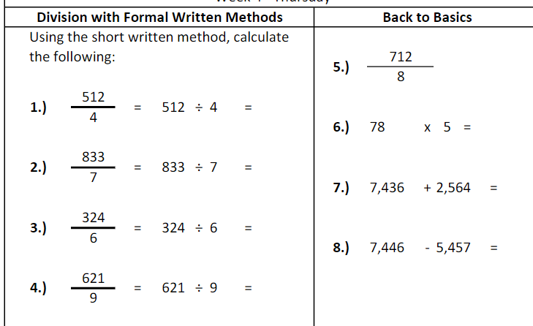

Slide 35
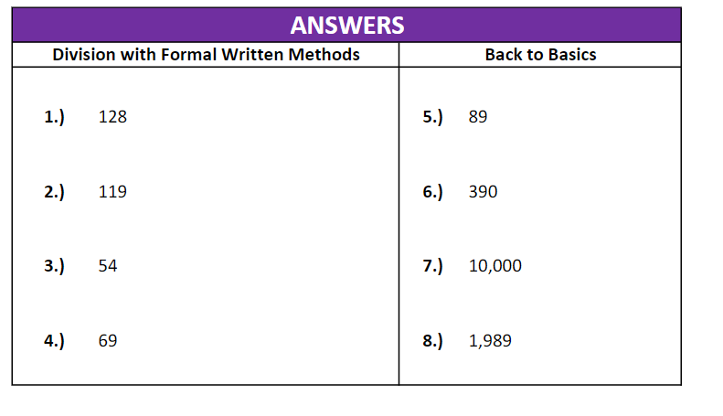

Slide 36
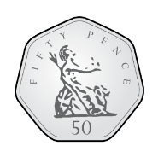
What would you rather have, five 50p coins or twelve 20p coins?
Explain your answer fully.

Slide 37
Addition and Subtraction
Subtraction: written methods and choosing strategies
Objectives
Day 4
Investigate patterns when subtracting 3-digit numbers.

Slide 38
Day 4: Investigate patterns when subtracting 3-digit numbers.
Work in pairs on a whiteboard – can you find which of these is right and which is wrong?
£2
£10 - £7.89 = £2.11
11p
£7.89
£8
£10
704 - 578 = 136
32
100
4
578
600
700
704

Slide 39
Day 4: Investigate patterns when subtracting 3-digit numbers.
Who spotted that?
What should the jump be from 578 to 600?
When counting up to solve subtraction, calculate the complements to 100 carefully!
704 - 578 = 136
32
100
4
578
600
700
704

Slide 40
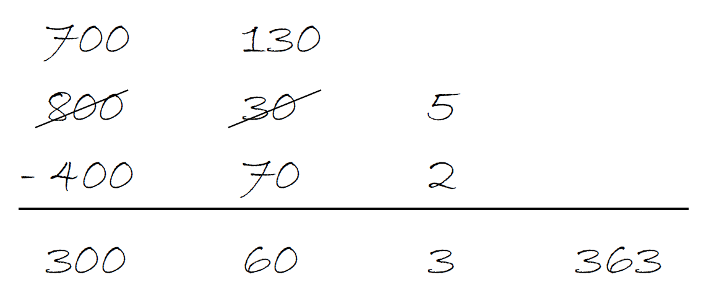
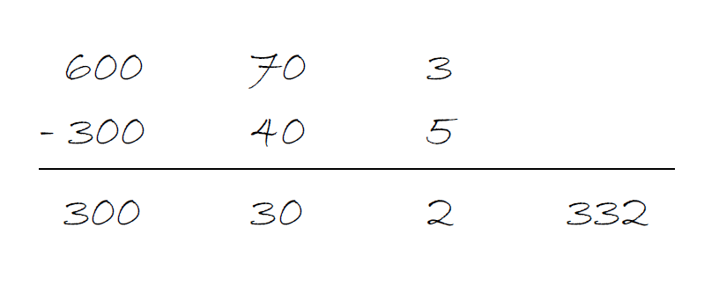
Day 4: Investigate patterns when subtracting 3-digit numbers.
Work in pairs on a whiteboard – can you find which of these is right and which is wrong?

Slide 41
Day 4: Investigate patterns when subtracting 3-digit numbers.
Who spotted that?
What should you do if the second number is larger than the first?
When using column subtraction remember to decompose if the second number is larger.

Slide 42
Day 4: Investigate patterns when subtracting 3-digit numbers.
Whole class investigation
Think of a 3-digit number and reverse the digits.
Using compact decomposition to subtract the smaller number from the larger, e.g. choose 873 and subtract 378.
Work in pairs to repeat with other pairs of numbers.
What do you notice? Is there anything in common about the digits in the answer? The sum of the digits? Does this work if the digits are consecutive / all different / some the same?
Try different types of examples to test out theories.
Notes:
Today’s GROUP ACTIVITY is this unit’s WHOLE CLASS INVESTIGATION. You can find more details in the unit’s TEACHING AND GROUP ACTIVITIES download.
WT: Use base 10 equipment to model the subtractions.
In the main investigation the middle digit will always be 9, unless all digits are the same, e.g. 555 – 555, and the sum of the digits will be 18, digital root 9.

Slide 43
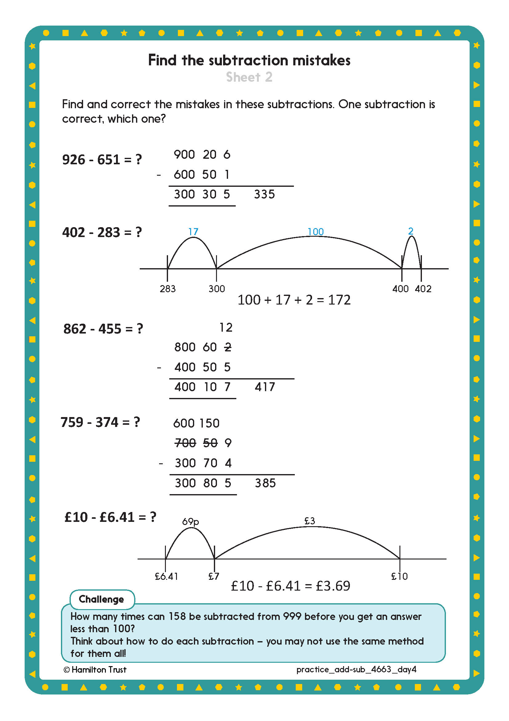
Challenge
Challenge
Notes:
The Practice Sheet on this slide is suitable for most children.
Differentiated PRACTICE WORKSHEETS are available on Hamilton’s website in this unit’s PROCEDURAL FLUENCY box.
WT: Find the subtraction mistakes Sheet 1.
ARE: Find the subtraction mistakes Sheet 2.
GD: Find the subtraction mistakes Sheet 3.

Slide 44
Addition and Subtraction
Subtraction: written methods and choosing strategies
Well Done! You’ve completed this unit.
Objectives
Day 1
Count up to solve 3-digit subtractions.
Day 2
Subtract 3-digit numbers using expanded column subtraction.
Day 3
Subtract 3-digit numbers choosing an efficient method.
Day 4
Investigate patterns when subtracting 3-digit numbers.
Notes:
You can now use the Mastery: Reasoning and Problem-Solving questions to assess children’s success across this unit. Go to the next slide.

Slide 45
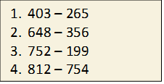
Problem solving and reasoning questions
Complete each diagram and find the missing numbers.
Here is Ali’s homework.
Advise him on the most efficient or error-proof subtraction strategy to calculate each one, explaining why you are suggesting that method. Work out the answers.
Complete this calculation that uses ‘decomposition’:
Fill the gaps in this subtraction:
81 – 4 7 = 46
604
387
912
 | 868
1003
578

Slide 46
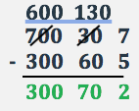
Problem solving and reasoning questions answers
Complete each diagram and find the missing numbers.
These are probably best-solved using Frog, counting up in appropriate jumps from the smaller to larger number.
Here is Ali’s homework.
Advise him on the most efficient or error-proof subtraction strategy to calculate each one,
explaining why you are suggesting that method. Work out the answers. 1. 138 – most efficiently solved by Frog.
2. 292 – also solve by Frog, some may prefer column subtraction for this one as neither number is close to a hundreds number, and only one column needs to be adjusted.
3. 553 – subtract 200 and add 1 back.
4. 58 – count up with Frog.
Complete this calculation that uses ‘decomposition’:
Fill the gaps in this subtraction:
813 – 467 = 346
604
387 | 217
912
44 | 868
1003
578 | 425

